Slide 1
Advances in New Church Theistic Science:
The mind-body connection
Ian Thompson
and the Theistic Science Group
www.theisticscience.com
General Church Assembly
Benade Auditorium, 1.45-3.15pm June 28, 2024.

Slide 2
Outline
Are Religion and Science separate or connected?
  They need each other.
Here: use ideas from the Writings of Swedenborg to advance science
  Use ideas of discrete degrees and influx.
  Propose changes to physics in order to explain the steps of the mind-body connection
  Suggest how these physical changes can be measured
Make a Theistic Science
  Theory that assumes the existence of God of theism

Slide 3

Personal Background
Studying theoretical physics and Swedenborg together for 50 years
Theoretical Nuclear Physicist
  Details at www.ianthompson.org
Overview of Theistic Science
(connecting discrete degrees): www.theisticscience.org
Book: “Starting Science with God” (Amazon, 2011)
  More information: www.beginningtheisticscience.com
Today I derive new ideas from this

Slide 4

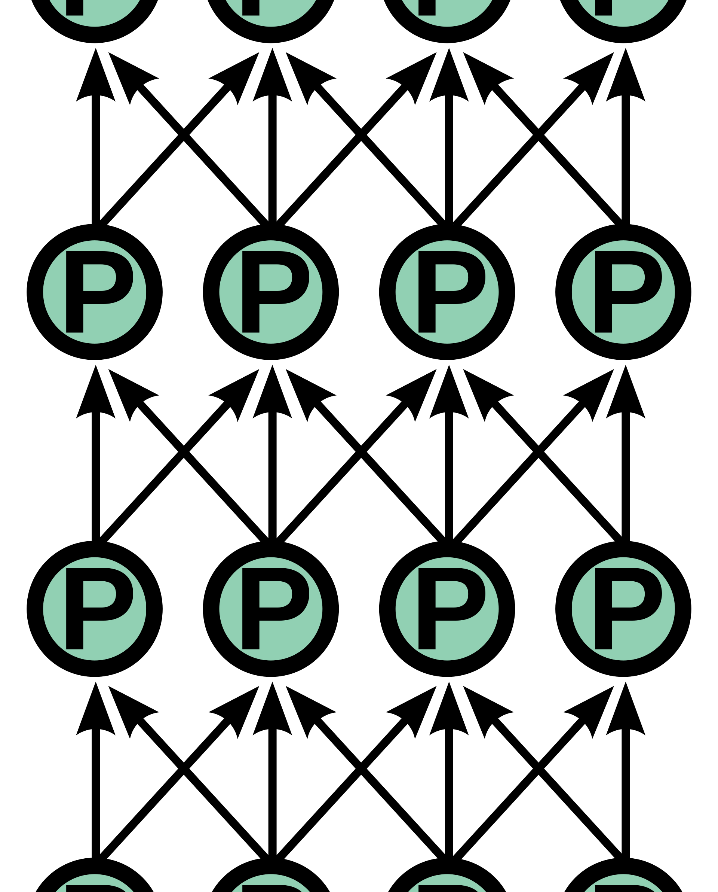
Mind-body Connection
Our minds and brain/body
definitely interact
From everyone’s daily experiences
Desire & thought -> Intention to act -> Bodily action
But most scientists and philosophers today
  say minds and bodies are so different in nature
  that we cannot even imagine how they interact.
  so deny any interaction!
  insist on ‘causal closure’ of the physical world
  Since the brain is all there is, say the brain itself
  must feel, think, act.
All causes physical (P) ?

Slide 5
Mind-body Connection
Our minds and brain/body definitely interact
  From everyone’s daily experiences
Mind and Body are distinct, but closely connected
We use ideas from Swedenborg to form a new theory
  Here use concept of discrete degrees connected by influx
  show how this theory predicts measurable effects
  to be part of an extended theistic science

Slide 6
Discrete Degrees
Swedenborg from HH 38.
Degrees are of two kinds:
  those that are continuous
  and those that are discrete
Discrete degrees are distinguished like
  prior and posterior,
  like cause and effect,
  what produces and what is produced.
Not measured by distance
Discrete Degrees needed to understand the differences between:
the heavens
the interior and exterior
faculties of a person,
the spiritual world and the natural world,
and between the spirit of a person and his body.
If these are taken as continuous, then we confuse spiritual and natural

Slide 7
HH 38 in full
38. Only he who knows how degrees are related to Divine order can comprehend how the heavens are distinct, or even what is meant by the internal and the external man. Most men in the world have no other idea of what is interior and what is exterior, or of what is higher and what is lower, than as something continuous, or coherent by continuity, from purer to grosser. But the relation of what is interior to what is exterior is discrete, not continuous. Degrees are of two kinds, those that are continuous and those that are not.
Continuous degrees are related like the degrees of the waning of a light from its bright blaze to darkness, or like the degrees of the decrease of vision from objects in the light to those in the shade, or like degrees of purity in the atmosphere from bottom to top. These degrees are determined by distance.
[2] On the other hand, degrees that are not continuous, but discrete, are distinguished like prior and posterior, like cause and effect, and like what produces and what is produced. Whoever looks into the matter will see that in each thing and all things in the whole world, whatever they are, there are such degrees of producing and compounding, that is, from one a second, and from that a third, and so on.
[3] Until one has acquired for himself a perception of these degrees he cannot possibly understand the differences between the heavens, nor between the interior and exterior faculties of man, nor the differences between the spiritual world and the natural world, nor between the spirit of man and his body. So neither can he understand the nature and source of correspondences and representations, or the nature of influx. Sensual men do not apprehend these differences, for they make increase and decrease, even according to these degrees, to be continuous, and are therefore unable to conceive of what is spiritual otherwise than as a purer natural. And in consequence they remain outside of and a great way off from intelligence.#
# Things interior and things exterior are not continuous but distinct and discrete according to degrees, and each degree has its bounds (n. 3691, 5114, 5145, 8603, 10099).
One thing is formed from another, and the things so formed are not continuously purer and grosser (n. 6326, 6465).
Until the difference between what is interior and what is exterior according to such degrees is perceived, neither the internal and external man nor the interior and exterior heavens can be clearly understood (n. 5146, 6465, 10099, 10181).
(Ager translation)

Slide 8
Connecting Discrete Degrees
Each degree has its own substances and forms in its realm.
Degrees come in threes (trines), of end + cause + effect.
  The end is ‘higher’, cause ‘middle’, and the effect is ‘lower’
  (spatial metaphor)
Influx connects degrees:
higher degrees produce something in the lower degree, depending on what is already in the lower degree.
So: ends in higher degrees cause lower-degree effects,
by means of the middle degree.
Produces correspondences

Slide 9
Degrees and Sub-degrees
All sustained
and connected
by influx
rightward &
downward:
Many
correspondences
SPIRIT
Mind
Physical

Slide 10
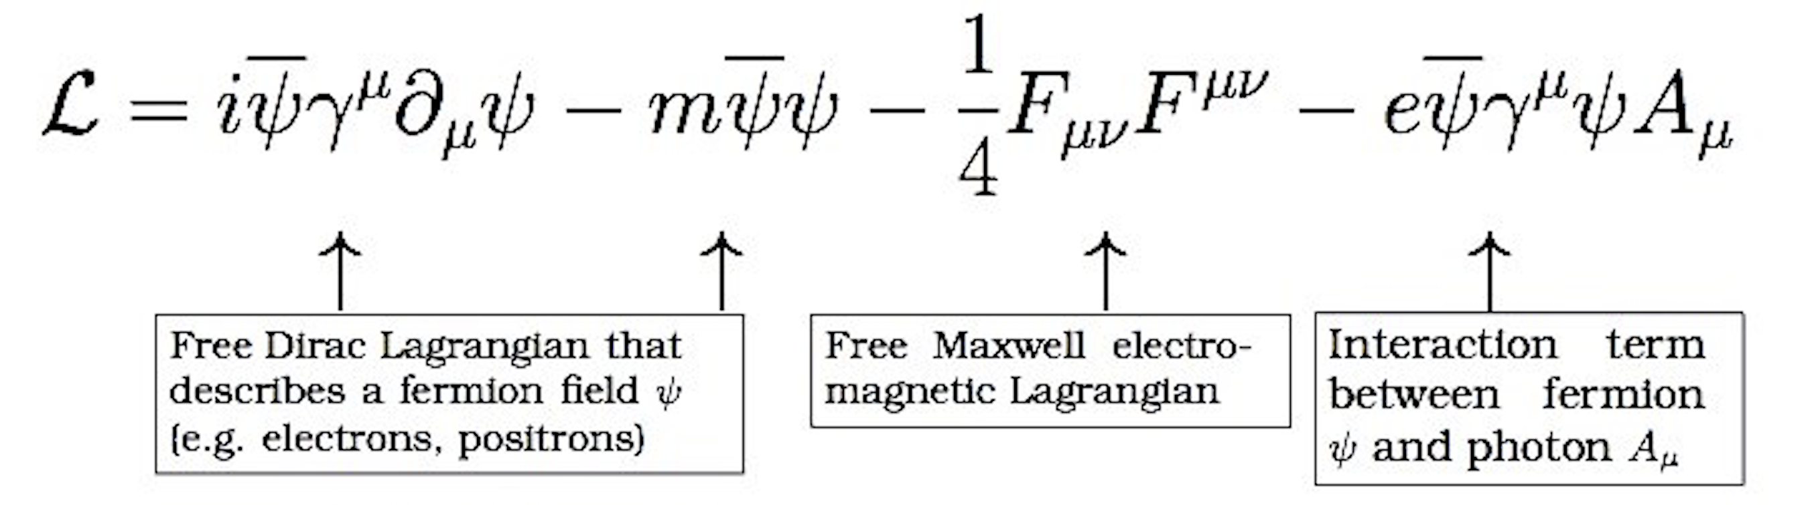
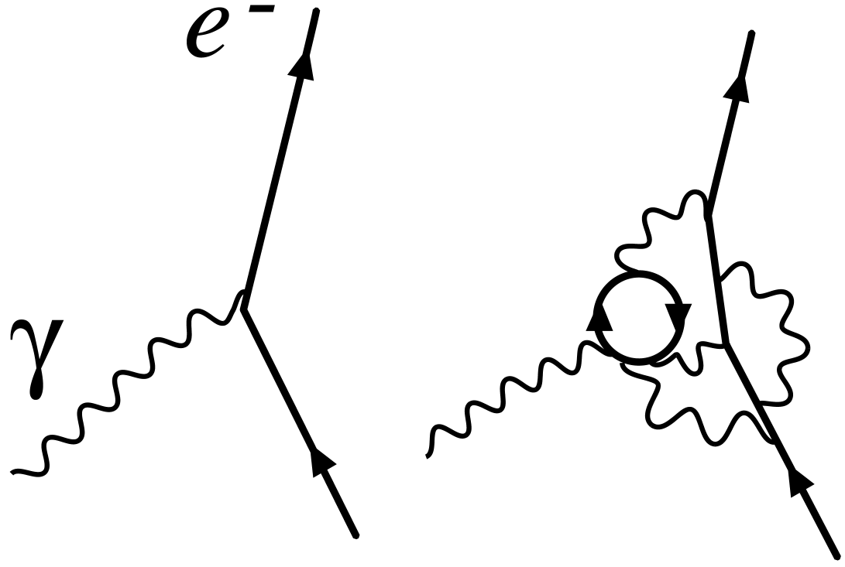
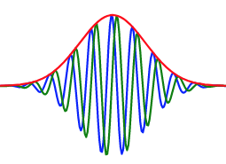
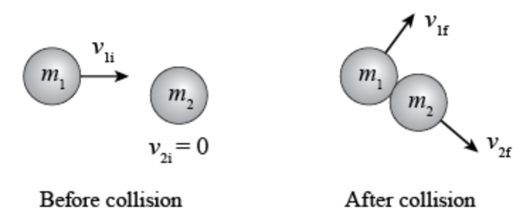
Discrete Degrees within the Physical
- going from causes to effects, all connected
Field Lagrangian gathers strengths of initial
interactions (bare masses m and charges e)
The effective masses and forces in quantum mechanics then determined by Quantum Field Theory
Quantum Mechanics then uses masses & forces for dynamics of particles, atoms and molecules.
  Described by Schrodinger Equation: HΨ(x,t) = i∂ Ψ(x,t)/∂ t
Most large objects then described well by classical Newtonian Physics:
  Forces acting on masses giving acceleration: F=ma.
But:
What determines initial bare masses and charges ?
Are there ends or targets? Is there a formative degree?

Slide 11
Mind & Body: Two Discrete Degrees
The mind and body are two such discrete degrees.
  They do need to be connected with correspondences.
  A will connection must convey intentions down:
  from the mind to the body. (discuss today)
  A sensory connections must convey information up:
  from the bodily senses to the mind (discuss another time).
  Have a dualism of mind and body, with specific connections
All these connections are by influx.
  This influx is from the mental degree into the physical degree.
  So we need to know
  when influx occurs,
  what are the prerequisites,
  what is produced in the lower degree
  things which correspond
Mental
Physical
Influx
Sense
information

Slide 12
Questions?

Slide 13
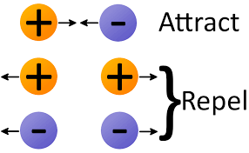
Current Physics
By standard science, there are four forces:
  Gravity (attractive)
  Electromagnetism
  Strong nuclear force (hold the nucleus together)
  Weak nuclear force (slow decay of free neutrons)
All 4 forces conserve energy in a closed universe.
Maybe also:
  Dark matter (so galaxies rotate more evenly)
  Dark energy (so whole universe expands slightly faster)
No sign here of spiritual or mental influx
  (except maybe to explain the initial Big Bang)

Slide 14
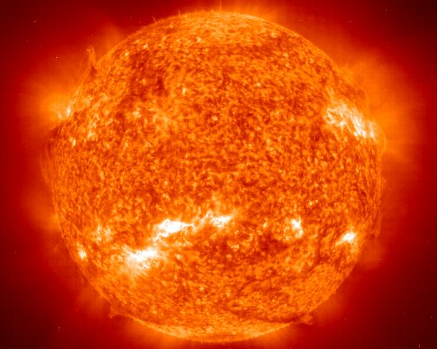
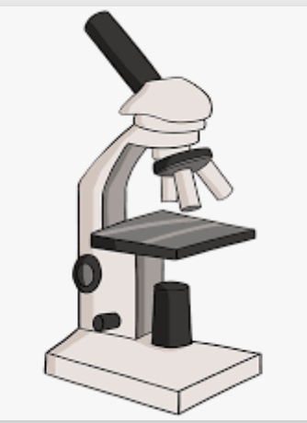

Spiritual effects on Physical
Something must be different in physics and physiology because of spiritual input:
Effects of mental desires and intentions
on neurons, leading to bodily movements
Effects in general cellular bio-chemistry: proteins etc.
Try to keep general physical theories:
Suns, microscopes, cell phones: all still work.
  Maintained by immediate influx into all non-living things
Find a ‘soft spot’ in physical theory so laws are not always fixed,
but laws vary as part of a bigger picture.

Slide 15

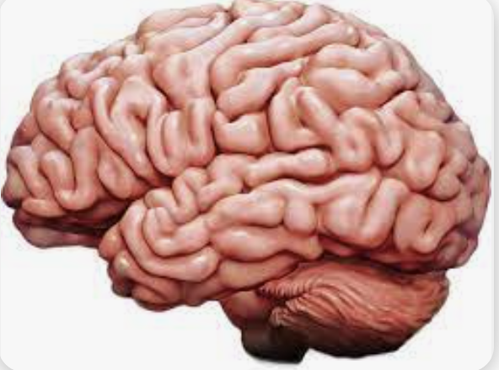
Where influx should be in physics
Mediate Influx from prior spiritual or mental discrete degrees should show up in these ways:
  within living organisms,
  especially within the smallest cells
  especially within the brains of mammals < mental
  especially within human brains < mental
Influx should make differences in all these ways
But what differences, exactly?
  How could we tell if influx is occurring or not?

Slide 16
Proposed effects of mental influx:
Another kind of ‘mental particle’ in the physical world
A fifth force called ‘mental force’ or ‘vital force’
Local modifications of existing physical forces:
gravity, electric, nuclear strong, or nuclear weak.
Influencing quantum measurements by biassing its random selections.
And/or giving ‘final causes’:
Providing ‘ends’ or ‘targets’ for physical processes

Slide 17
What would we expect in the world described in the Writings?
Expect influx to provide ends/targets (5.): final causes.
Expect influx into the existing physical – as in when modifying existing forces (3.) or existing random processes (4.)
The quantum proposal (4.) has been often suggested.
But it has only extremely small effects in the warm fluctuating environment of living cells.
So I recommend (3. with 5. ) –
modifying existing forces to achieve ends given as targets

Slide 18
Varying electric forces for targets
Proposal:
Ends in mental degree are received by influx into the physical degree as targets.
The strengths of electric forces are varied locally in cells to achieve those targets at the needed times.
Physics in Living Systems
All living systems have bodies made of protons, neutrons, electrons. These make up assemblies of atoms, ions, molecules, cells, etc
Atoms, ions and molecules should behave slightly differently
because of spiritual influx
Mind is not just electricity in the brain (a common idea),
but Mind controls electric forces there.

Slide 19
Questions?

Slide 20
Connecting outermost mental degree with innermost physical degree
Outermost
Mental:
sensorimotor
New
Connection!
Lagrangian
Masses and Charges
Quantum
Objects
The sensorimotor degree is outermost mental degree
The Lagrangian is the inmost-known physical degree
This is where some connection should be expected!
Would expect new degree between them to form a trine.
Proposal:
The mental influences values of the electric charges

Slide 21
Are Lagrangian coefficients fixed?
Many people think so.
  See ‘Parameters of the Standard Model’ in Wikipedia.
But these observed values are not the starting parameters.
RATHER:
  By a process called ‘renormalization’, the initial numbers are tuned to give the observed numbers as output.
But renormalization method is not fixed in theory.
  Method could be fine-tuned depending on place and time!
  Starting numbers could give varying masses and charges.

Slide 22
Have Charge Variations been seen?
Perhaps comparing with very distant stars:
John Webb et al, (2001, 2011):
  Measured variations in ratios of frequencies of spectral lines
  Found evidence that the electron charge q is very slightly smaller for distant stars (that is, in the past),
  by 1 part in 10^{5:}
So: variations are conceivable
not James Webb

Slide 23
Mental Effects on the Physical
Our idea:
the fine-tuned parameters (masses, charges) can be varied locally in order to achieve ends in nature.
We will focus on electric charges.
Physicists have proposed varying charges over the age of the universe.
Now new idea: to vary it over micro-seconds,
and within living organisms

Slide 24
Varying electric charge: mental effect
?
‘Physical ends’ degree that controls quantum fields
This is real fine-tuning,
  not gradually over whole universe (or just the Big Bang),
  but differently at each time in each place in an organism
  “Local”, not “global” physics variations!
We suggest that this is specific to living organisms. That it occurs at all scales of psychology and biology: every day and every second of our lives.

Slide 25
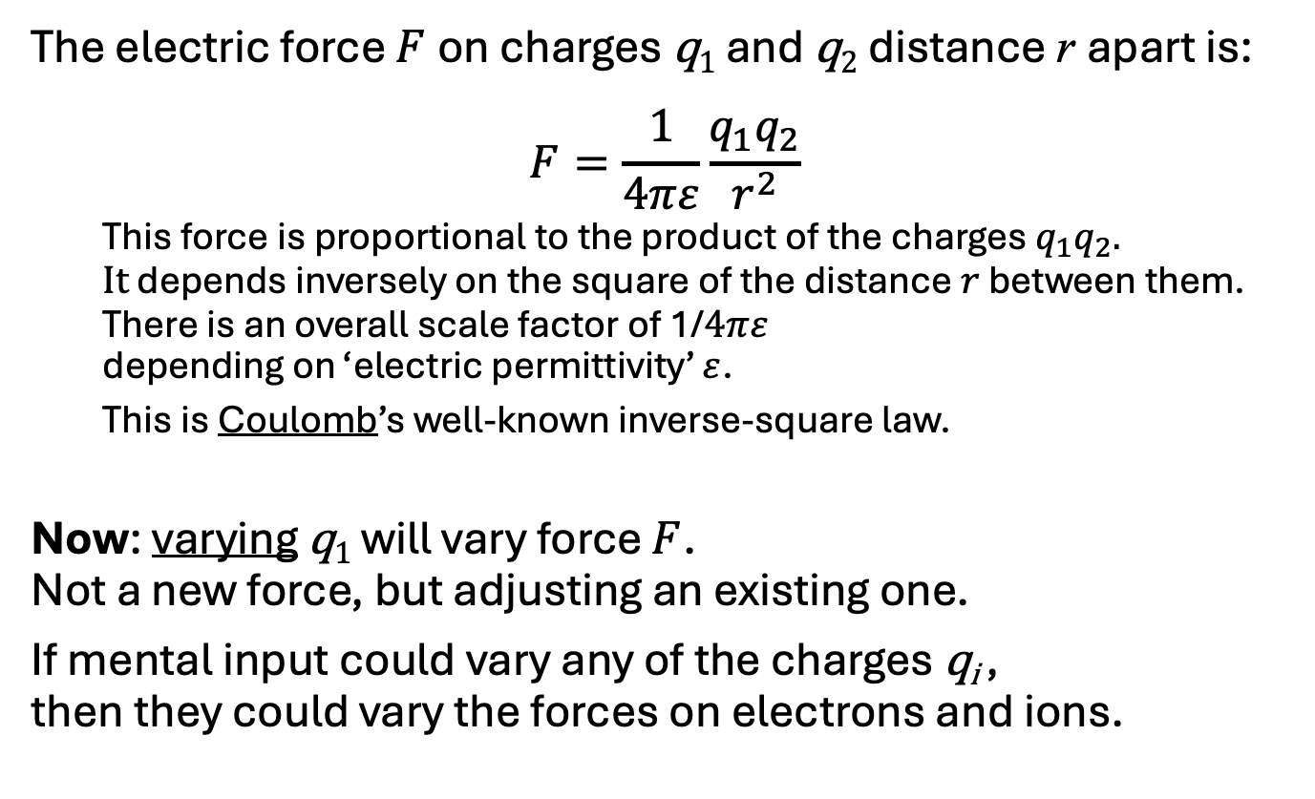
Electric Forces (the inverse square law)
The electric force $F$on charges q₁ and q₂ distance r apart is:
$$F=\frac{1}{4πε}\frac{{q_{1}q}_{2}}{r^{2}}$$
  This force is proportional to the product of the charges ${q_{1}q}_{2}.$
  $It$ depends inversely on the square of the distance $r$ between them. There is an overall scale factor of 1/$4πε$
  depending on ‘electric permittivity’ $ε$.
  This is Coulomb’s well-known inverse-square law.
Now: varying q₁ will vary force $F$.
Not a new force, but adjusting an existing one.
If mental input could vary any of the charges q_{i} ,
then they could vary the forces on electrons and ions.

Slide 26
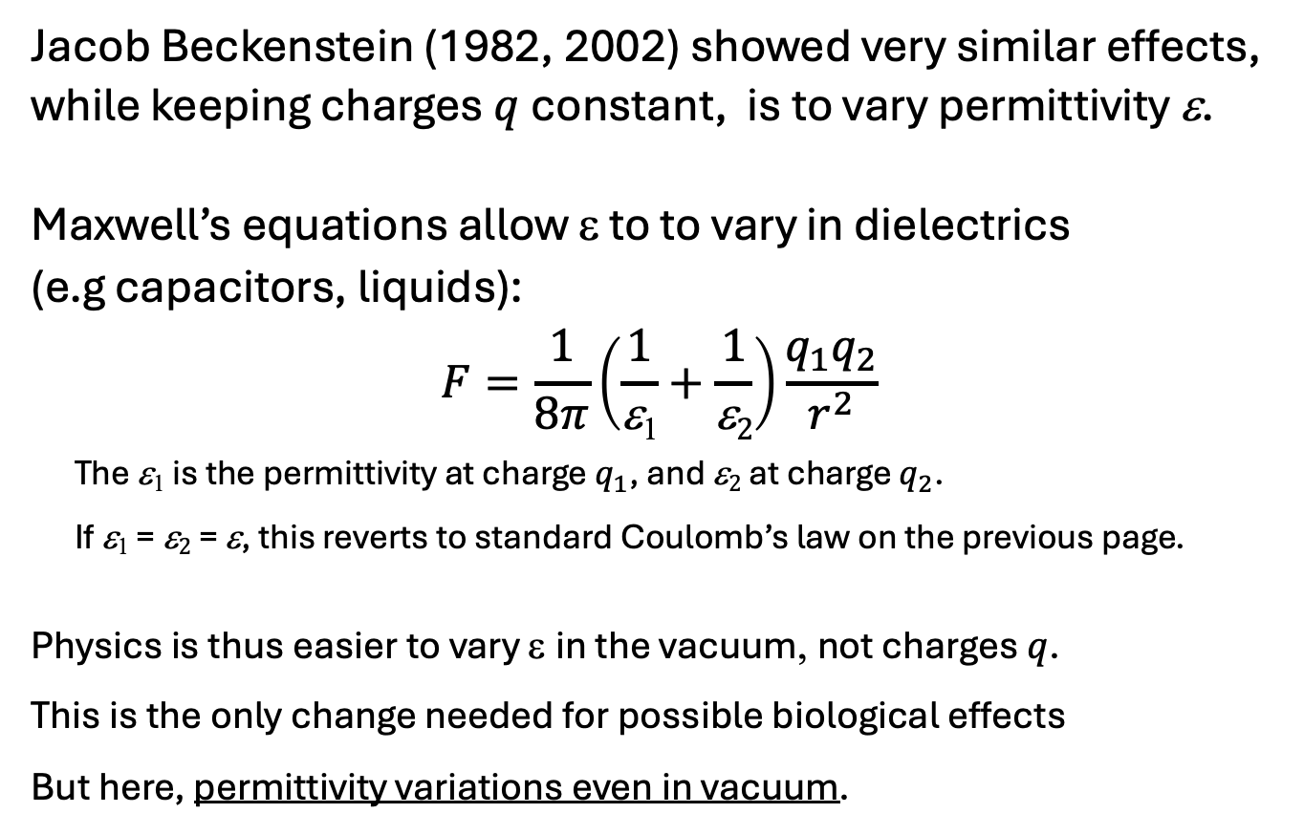
Electric Permittivity Varies
Jacob Beckenstein (1982, 2002) showed very similar effects, while keeping charges $q$constant, is to vary permittivity ε.
Maxwell’s equations allow ε to to vary in dielectrics
(e.g capacitors, liquids):
$$F=\frac{1}{8π}\left(\frac{1}{\text{e}\text{1}}+\frac{1}{\text{e}2}\right)\frac{{q_{1}q}_{2}}{r^{2}}$$
The $\text{e}\text{1}$ is the permittivity at charge $q_{1}$, and $\text{e}2$ at charge $q_{2}$.
If $\text{e}\text{1}$ = $\text{e}2$ = $\text{e}$, this reverts to standard Coulomb’s law on the previous page.
Physics is thus easier to vary ε in the vacuum, not charges $q$.
This is the only change needed for possible biological effects
But here, permittivity variations even in vacuum.

Slide 27
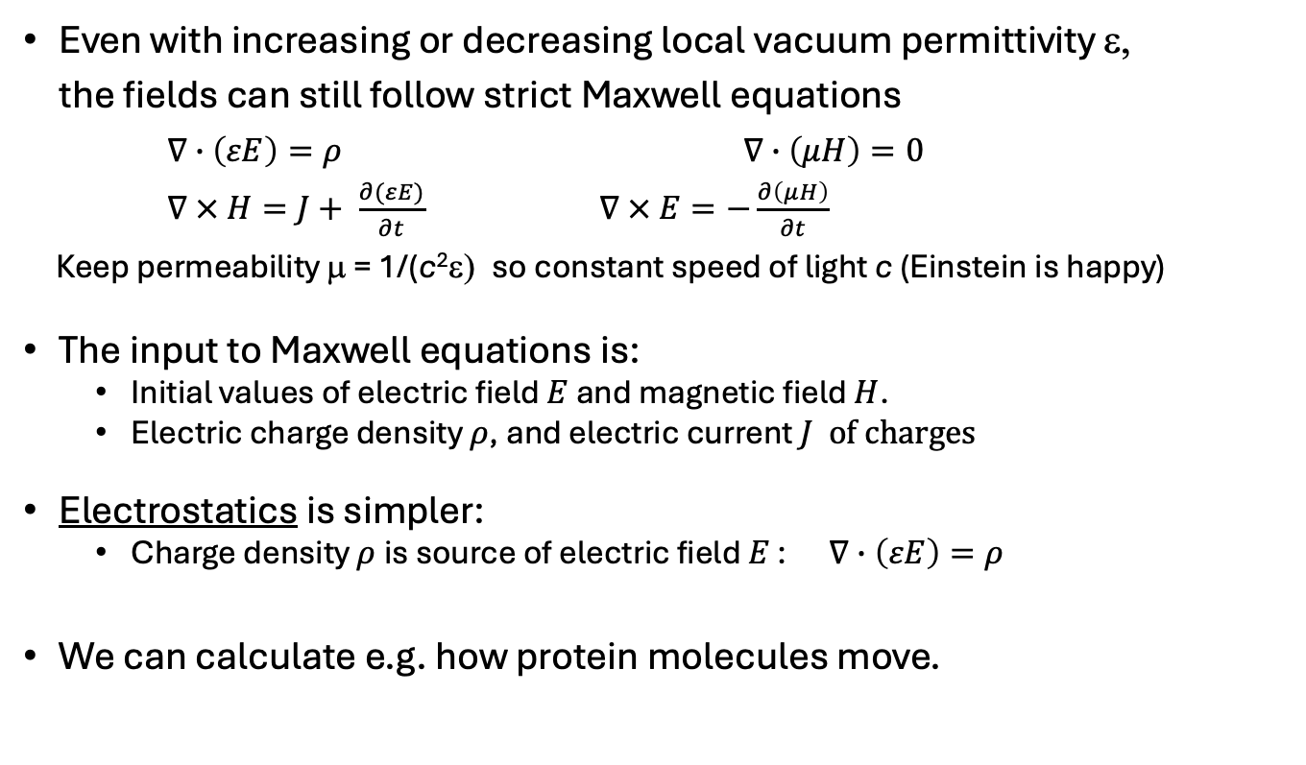
Electromagnetic fields
Even with increasing or decreasing local vacuum permittivity ε,
the fields can still follow strict Maxwell equations
$∇∙\left(εE\right)=ρ$ $∇∙\left(μH\right)=0$
$∇ × H=J+ \frac{∂(εE)}{∂t}$ $∇ × E=−\frac{∂\left(μH\right)}{∂t}$
Keep permeability μ = 1/(c²ε) so constant speed of light c (Einstein is happy)
The input to Maxwell equations is:
  Initial values of electric field $E$ and magnetic field $H$.
  Electric charge density $ρ$, and electric current $J of charges$
Electrostatics is simpler:
  Charge density $ρ$is source of electric field $E$ : $∇∙\left(εE\right)=ρ$
We can calculate e.g. how protein molecules move.

Slide 28
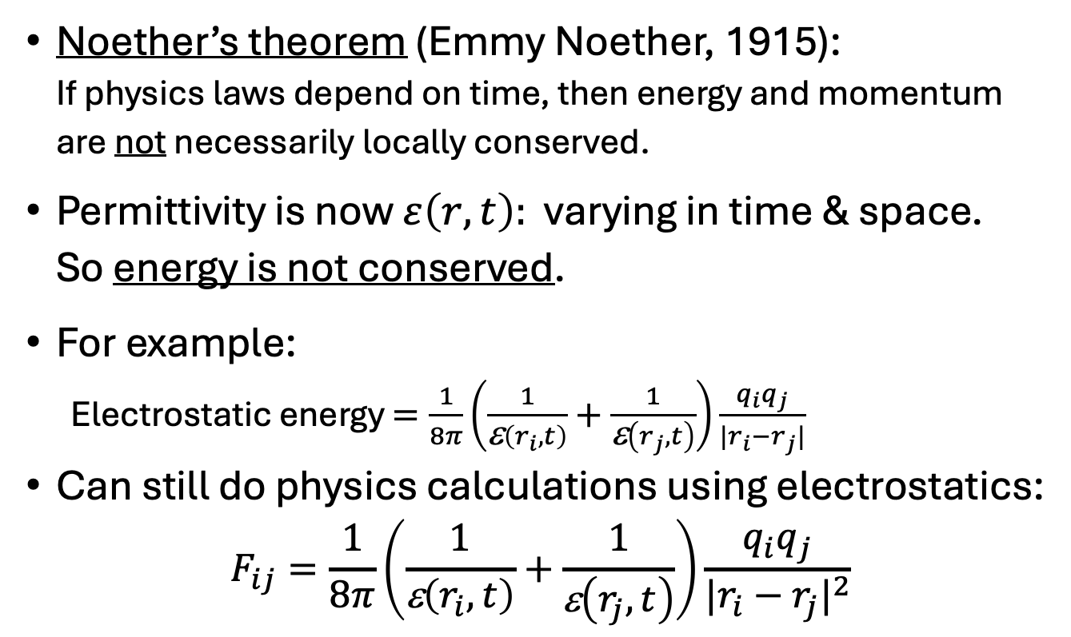
Energy is not always conserved
Noether’s theorem (Emmy Noether, 1915):
If physics laws depend on time, then energy and momentum are not necessarily locally conserved.
Permittivity is now $ε\left(r,t\right):$ varying in time & space.
So energy is not conserved.
For example:
Electrostatic energy $=\frac{1}{8π}\left(\frac{1}{\text{e}\left(r_{i},t\right)}+\frac{1}{\text{e}\left(r_{j},t\right)}\right)\frac{{q_{i}q}_{j}}{|r_{i}−r_{j}|}$
Can still do physics calculations using electrostatics:
$$F_{ij}=\frac{1}{8π}\left(\frac{1}{\text{e}\left(r_{i},t\right)}+\frac{1}{\text{e}\left(r_{j},t\right)}\right)\frac{{q_{i}q}_{j}}{{|r_{i}−r_{j}|}^{2}}$$

Slide 29
Other schemes trying to keep Conservation of Energy
Physics extensions have been proposed which keep
  Energy conservation and
  Causal closure of the physical.
For example:
  Biased probabilities in quantum mechanics (John Eccles)
  Varying time of probabilistic events (Henry Stapp)
  Moving energy from one location to a nearby place
  But this does not conserve energy locally.
  Non-local entanglement (Amit Goswami)
  But cannot be used for signals.
Remember: changes in quantum chances are very small!
Electric changes are bigger.

Slide 30
Questions?

Slide 31
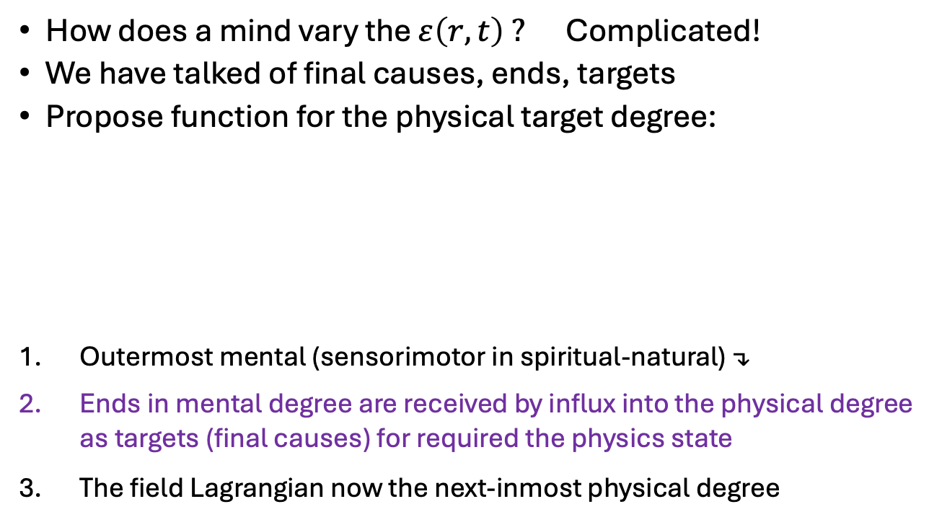

Achieving useful ends: Targets.
Consistent degrees
How does a mind vary the $ε\left(r,t\right) ?$ Complicated!
We have talked of final causes, ends, targets
Propose function for the physical target degree:
Outermost mental (sensorimotor in spiritual-natural) ↴
Ends in mental degree are received by influx into the physical degree as targets (final causes) for required the physics state
The field Lagrangian now the next-inmost physical degree
Outermost
mental
(sensorimotor)
influx
Targets
final cause
Lagrangian
Masses and Charges
Quantum
Objects
Varies
$$ε\left(r,t\right)$$

Slide 32
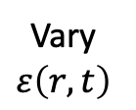
Achieving Targets in New Physics
Michael Levin (2012): cells need feedback system to
  1) know the shape S it is supposed to achieve (target),
  2) tell if its current shape S₀ differs from this target,
  3) compute means-ends analysis to get from S₀ to S,
  4) perform a kind of self-surveillance to know when the desired shape has been reached.
Need extra step:
Difference (current–target)
Outermost
mental
(sensorimotor)
Targets
Lagrangian
Masses and Charges
Influx
Vary
$$ε\left(r,t\right)$$
Quantum
Objects

Slide 33
Example of feedback:
Picking up a cup
Desire to pick up a cup
Imagine ahead to see where hand is going to be
Compare final hand position with cup position
If see a possible mismatch.
Work backwards to present, see where hand is:
Work out how arm muscles have to move to reduce mismatch, so hand can grasp cup.
These are the same steps (a-f).

Slide 34
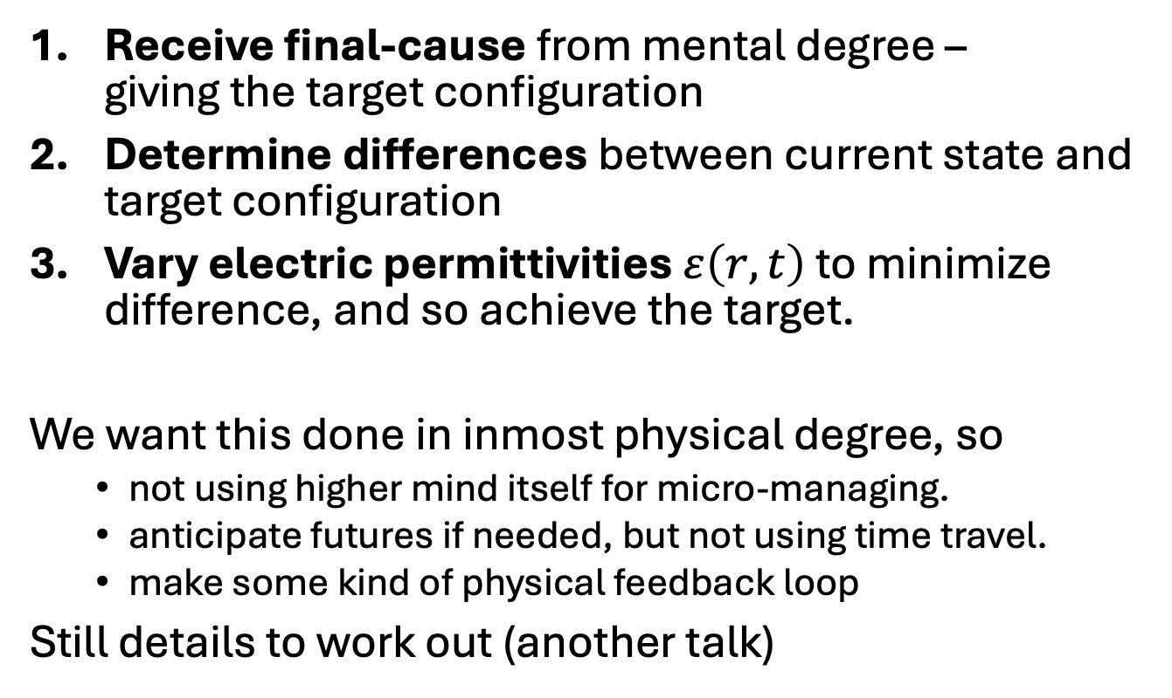
Three Function of Targets
Receive final-cause from mental degree –
giving the target configuration
Determine differences between current state and target configuration
Vary electric permittivities $ε\left(r,t\right)$ to minimize difference, and so achieve the target.
We want this done in inmost physical degree, so
  not using higher mind itself for micro-managing.
  anticipate futures if needed, but not using time travel.
  make some kind of physical feedback loop
Still details to work out (another talk)

Slide 35
Questions?

Slide 36
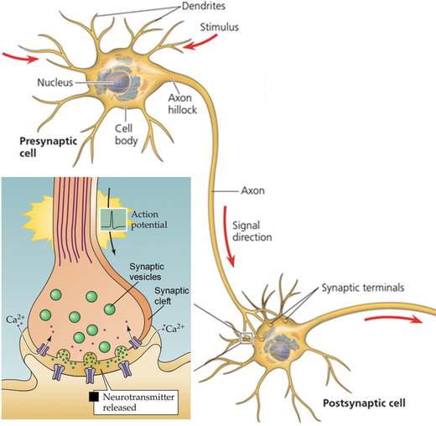
Neural Signals in the Brain
Signalling via synapses:
Electric ‘action potential’ comes in
Releases neuro-transmitters from synaptic vesicles
These electrically excite receptor neuron
If enough excitation, receptor neuron fires.

Slide 37
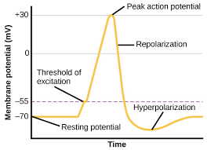
Electric thresholds at synapses in two places
Initial neuron: effect of electric pulse
Probability of incoming action potential
to release molecules from synaptic vesicle
is about 15 to 25 %
Receptor neuron: making new electric pulse
Many neurotransmitters combine to produce excitatory potentials in the receptor neuron.
The receptor may or may not fire.
(Maybe related to neuronal memories?)
Ideas from Beck & Eccles (1992)

Slide 38
Mental influences on neurons
Both thresholds on the initial and receptor neurons appear to be related to electric voltages.
So both thresholds can be fine-tuned by mental influx, to achieve targeted final neural patterns.
Mental influx can modulate activity of many neurons
The brain can detect these patterns & cause actions
Therefore : minds can control bodily actions.
Showing how this happens is the aim of this talk.

Slide 39
Experimental Test of Predictions
General prediction:
Processes with charged particles can be led to targeted results.
Specific predictions:
  Electric effects in living organisms fluctuate for targets
  Vacuum Permittivity changes in atoms and in cells
    Must distinguish from solvent permittivity changes
  This model only changes the physics parameters needed to get useful results – probably not all surrounding region.
    So must measure energy level changes in atoms in causal chain
    Atoms have brief shifts in energies and fluorescent light

Slide 40
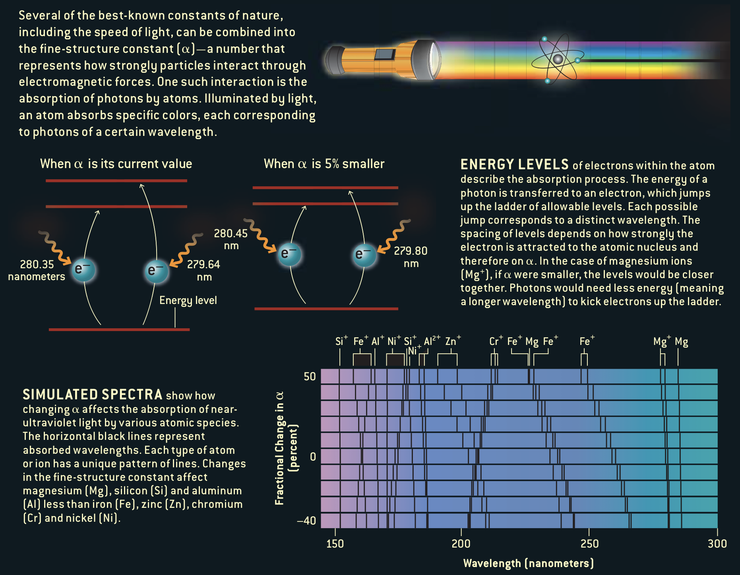
Measuring fluorescence spectra
from:
John Barrow &
John Webb,
Scientific
American
(2005) 56-63.

Slide 41
Summary of overall answers:
We can propose two hypotheses to answer the questions:
WHAT do mental (etc.) effects change in physics?
Answer: The electric permittivity of the vacuum
HOW these changes could be used in physiology?
Answer: For target configurations given by input from the spiritual/mental into cells, there is a physical feedback mechanism to bring physical forms closer to this target in the near future.

Slide 42
Implications
How spiritual things could have effects in nature.
These effects on permittivity should be measurable
Final causes and targets should be active in nature.
  We have a way to bring the future into line,
  without time travel.
Widens the field of scientific explanations concerning spiritual and mental causes.
No longer is the physical universe causally closed.

Slide 43
Questions?

Slide 44
References
Webb, J.K. (2001), M T Murphy, V V Flambaum, V A Dzuba, J D Barrow, C W Churchill, J X Prochaska, and A M Wolfe, Further Evidence for Cosmological Evolution of the Fine Structure Constant, Phys Rev Lett, 87, 205-4.
Webb, J. K. (2011), King, J. A., Murphy, M. T. and Flambaum, V. V. and Carswell, R. F. and Bainbridge, M. B., Indications of a Spatial Variation of the Fine Structure Constant, Phys. Rev. Lett. 107, 191101.
Bekenstein, J.D. (1982). Fine Structure Constant: Is It Really a Constant? Phys Rev, D25, 1527.
Bekenstein, J.D. (2002) Fine-structure constant variability, equivalence principle, and cosmology. Phys Rev D, 66, 884.
Levin, M. (2012) Morphogenetic fields in embryogenesis, regeneration, and cancer: Non-local control of complex patterning, Biosystems, 109, 243
F. Beck and J.C. Eccles (1992), Quantum Aspects of Brain Activity and the role of consciousness, Proc. Natl. Acad. Sci, 89, 11357

Slide 45
Theistic Science Group
Thanks to the Theistic Science group!
  Many discussions over recent years.
Ron Horvath, Stephen Smith, Andy Heilman, Reuben Bell, Forest Dristy, Gard Perry,
Prescott Rogers, Fernando Caracena, Clark Echols and others

