Slide 1
An hypothesis for
How Influx into the Natural
Shows Itself in Physics
Breaking the shell.
No more ‘closure of the physical’
Ian Thompson
www.ianthompson.org

Slide 2
Parts of this talk
Overview
WHAT influx changes in physics
HOW influx changes could be used in physics
Numerical Demonstrations

Slide 3
1. Overview

Slide 4
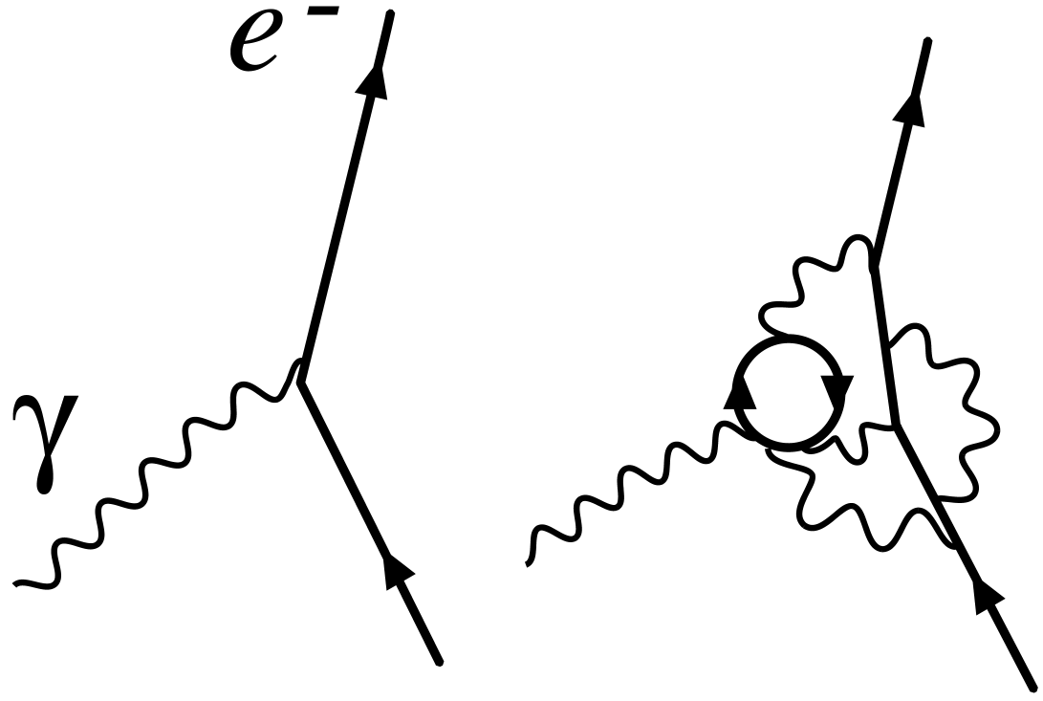
Physics we do not understand
Remember:
3.1 degree of gravity ??
  Big debate for last 90 years on how to link the gravity of Einstein’s “General Relativity” with quantum physics.
  Can we formulate ‘quantum gravity’? No luck so far.
3.1 degree for ‘fine tuning’ parameters in QFT ??
  QFT does not deliver ‘out of the box’.
  “Renormalized parameters” have to be fine-tuned to observed values, to fix:
    Higg’s mass (a hard problem)
    Quark masses, electron mass, unit charge (a bit easier)
3.1 linking the spiritual with the natural ??
  No-one trying that yet ! Should we try? Yes.

Slide 5
Physics we do not understand
Remember:
3.1 degree of gravity ??
  Big debate for last 90 years on how to link the gravity of Einstein’s “General Relativity” with quantum physics.
  Can we formulate ‘quantum gravity’? No luck so far.
3.1 degree for ‘fine tuning’ parameters in QFT ??
  QFT does not deliver ‘out of the box’.
  “Renormalized parameters” have to be fine-tuned to observed values, to fix:
    Higg’s mass (a hard problem)
    Quark masses, electron mass, unit charge (a bit easier)
3.1 linking the spiritual with the natural ??
  No-one trying that yet ! Should we try?
Now I am going to link these two

Slide 6
Linking Fine-tuning with Influx
I propose that this 3.1 degree is where ‘ends’ are received into physics
  Ends to determine the ‘means’
  Ends to manage (influence) the physical fields.
This is ‘fine-tuning’,
  not once for the whole universe (setting masses in Big Bang),
  but differently at each time in each place.
  “Local”, not “global” physics variations!
We suggest that this is specific to living organisms. That it occurs at all scales of psychology and biology: every day and every second of our lives.
What is the mechanism of this? How would we detect it happening? Test the idea?

Slide 7
Effect of Influx into the Physical
Our idea:
the fine-tuned parameters (masses, charges) can be varied locally in order to achieve ends in nature.
We will focus on charge e.
This is in ‘fine structure constant’ α = e²/ℏc = 1/137
Many physicists have proposed varying α over the age of the universe. So variations are conceivable.
Now we propose to vary it over micro-seconds,
and within living organisms, for uses. A new idea.

Slide 8
Digression on Time: metric & process times
Swedenborg is emphatic there are 2 kinds of time:
  Natural time (clock time)
  DLW 73: “Space in nature is measurable, and so is time. This is measured by days, weeks, months, years, and centuries.”
  Spiritual time of changes of state (successive actions of love)
  DLW 73: “But in the spiritual world it is different. The progressions of life in that world appear in like manner to be in time. . . but in place of these there are states of life, by which a distinction is made which cannot be called, however, a distinction into periods, but into states”
There are corresponding 2 kinds of time useful in quantum physics:
  Metric time as part of 4-dimensional space-time
  Process time for propensity actualizations in 4D spacetime (measurements).
We are going to use both kinds of time.

Slide 9

Specific New Church ideas for
How love operates with wisdom
Input of Ends from above that defines a goal.
Foresight of the present up to that time
A measure of goal mismatch (discrimination)
A way to work on mismatch, thinking back to present
A way to work out how to change causes (now & soon)
to reduce the mismatch (making a plan).
I will show a way how to do steps (b, c, d, e) in physics. With just dumb particles and fields: no consciousness involved in physics itself (the natural).
Do this with physics degrees 3.3, 3.2 known, and 3.1 proposed

Slide 10

Example:
Picking up a cup
Desire to pick up a cup
Imagine ahead to see where hand is going to be
Compare final hand position with cup position
If see a possible mismatch.
Work backwards to present, see where hand is:
Work out how arm muscles have to move to reduce mismatch, so hand can grasp cup.
These are the same steps (a-f).

Slide 11
2. WHAT influx changes in physics

Slide 12
Effect of Influx into the Physical
Remember:
Our idea:
Masses and charges can be varied locally in order to achieve ends in nature.
We will focus on charge e.
This is in ‘fine structure constant’ α = e²/ℏc = 1/137
Many physicists have proposed varying α over the age of the universe. So variations are conceivable.
Now we propose to vary it over micro-seconds,
and within living organisms, for uses. A new idea.

Slide 13
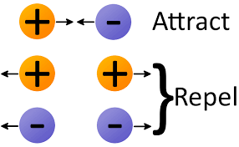
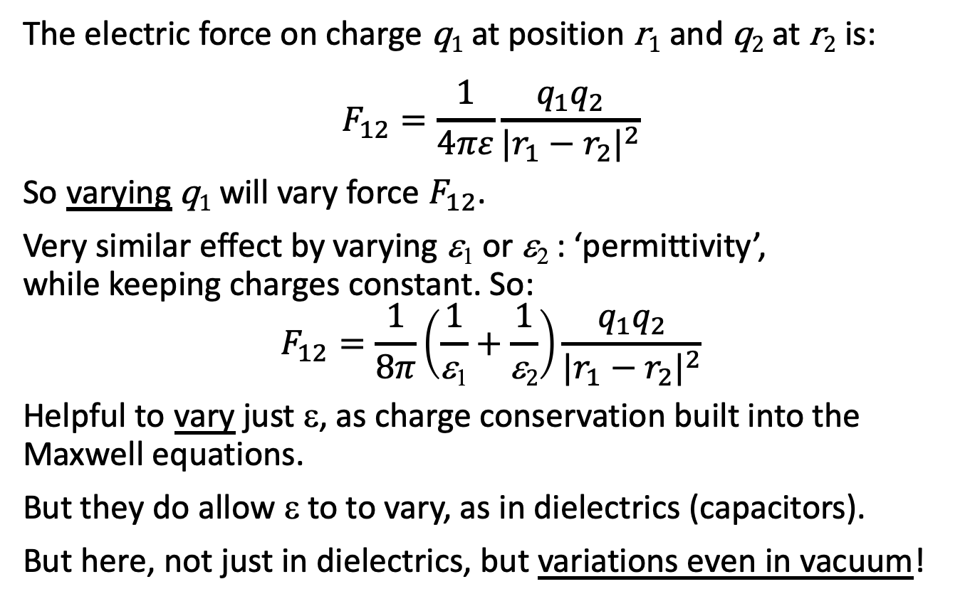
Electric Forces (inverse square law)
The electric force on charge q₁ at position r₁ and q₂ at r₂ is:
$$F_{12}=\frac{1}{4πε}\frac{{q_{1}q}_{2}}{{|r_{1}−r_{2}|}^{2}}$$
So varying q₁ will vary force $F_{12}$.
Very similar effect by varying ε₁ or ε₂ : ‘permittivity’,
while keeping charges constant. So:
$$F_{12}=\frac{1}{8π}\left(\frac{1}{\text{e}\text{1}}+\frac{1}{\text{e}2}\right)\frac{{q_{1}q}_{2}}{{|r_{1}−r_{2}|}^{2}}$$
Helpful to vary just ε, as charge conservation built into the Maxwell equations.
But they do allow ε to to vary, as in dielectrics (capacitors).
But here, not just in dielectrics, but variations even in vacuum!

Slide 14
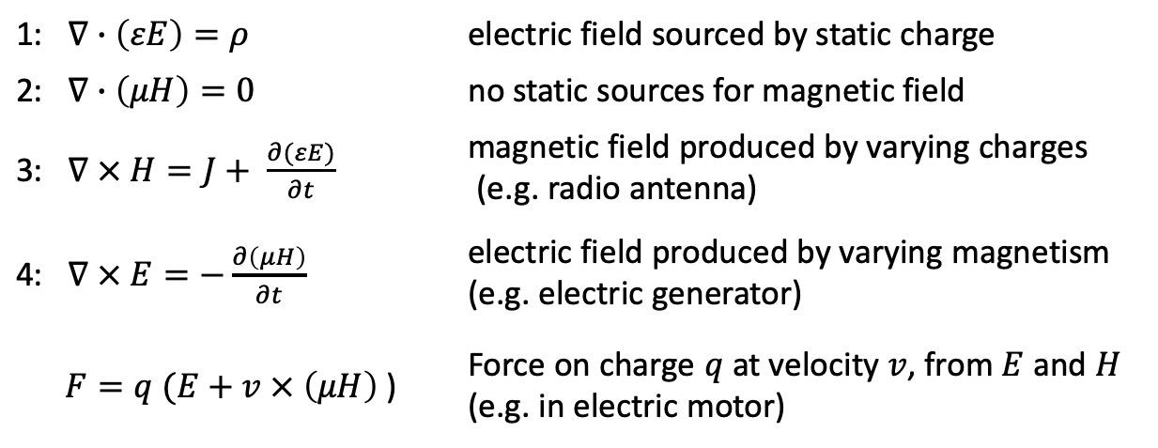
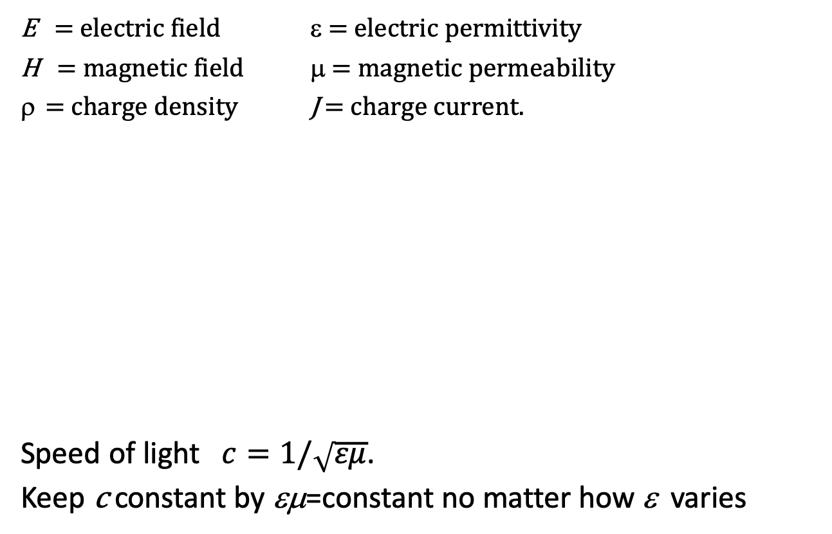
The four Maxwell Equations in a dielectric
standard
physics
E = electric field ε = electric permittivity
H = magnetic field μ = magnetic permeability
= charge density J = charge current.
Speed of light $c=1/\sqrt{εμ}$.
Keep c constant by εμ=constant no matter how ε varies
1: $∇∙\left(εE\right)=ρ$ | electric field sourced by static charge
2: $∇∙\left(μH\right)=0$ | no static sources for magnetic field
3: $∇ × H=J+ \frac{∂(εE)}{∂t}$ | magnetic field produced by varying charges (e.g. radio antenna)
4: $∇ × E=−\frac{∂\left(μH\right)}{∂t}$ | electric field produced by varying magnetism (e.g. electric generator)
$F=q (E+v × \left(μH\right)$ ) | Force on charge $q$ at velocity $v$, from $E$ and $H$ (e.g. in electric motor)

Slide 15
Conservation of Energy?
For minds to have effects, physics must be extended . . .
Many physics extensions have been proposed which keep
  Energy conservation, and
  Causal closure of the physical.
For example:
  Biased probabilities in quantum mechanics
  Varying time of probabilistic events (Stapp)
  Moving energy from one location to a nearby place (does not conserve energy locally)
  Non-local entanglement (but cannot be used for signals)
Remember: changes in quantum chances are very small!

Slide 16
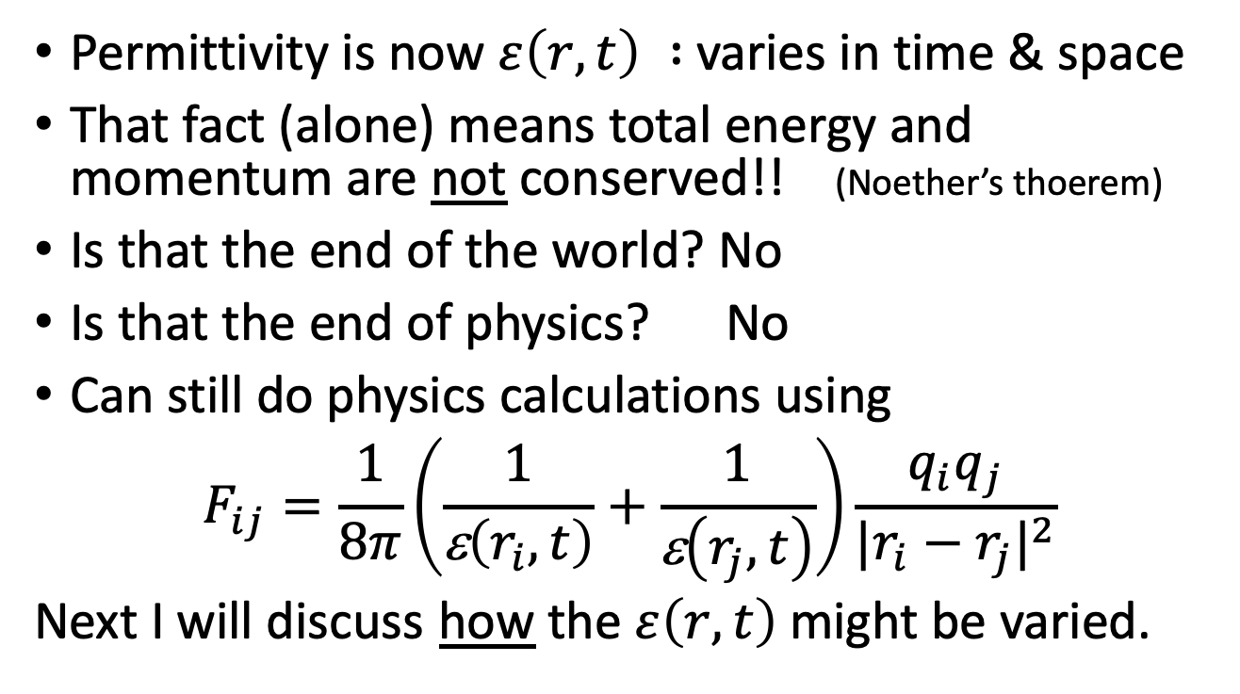
Conservation of Energy?
Permittivity is now $ε\left(r,t\right) :$varies in time & space
That fact (alone) means total energy and momentum are not conserved!! (Noether’s thoerem)
Is that the end of the world? No
Is that the end of physics? No
Can still do physics calculations using
$$F_{ij}=\frac{1}{8π}\left(\frac{1}{\text{e}\left(r_{i},t\right)}+\frac{1}{\text{e}\left(r_{j},t\right)}\right)\frac{{q_{i}q}_{j}}{{|r_{i}−r_{j}|}^{2}}$$
Next I will discuss how the $ε\left(r,t\right)$ might be varied.

Slide 17
3. HOW influx changes could be used in biology

Slide 18
Want correspondences in physics for:
How love operates with wisdom
Remember
the cup?
Input of Ends from above that defines a goal.
Foresight of the present up to that time
A measure of goal mismatch (discrimination)
A way to work on mismatch, thinking back to present
A way to find causes (now & soon) to reduce the mismatch (making a plan).
I will show a way how to do steps (b, c, d, e) in physics. With just dumb particles and fields: no consciousness involved in physics itself (the natural).
Do this with physics degrees 3.3, 3.2 known, and 3.1 proposed

Slide 19
(a) Input of Ends from above
(by influx) to define a goal.
This is what comes from the 1.x spiritual degree and the 2.x external mental degree, into 3.1 degree
1.1 Love for love itself | 2.1 Wisdom about love | 3.1 Use from love
1.2 Love for wisdom | 2.2 Wisdom about wisdom | 3.2 Use from wisdom
1.3 Love for use | 2.3 Wisdom about use | 3.3 Use as use itself.
Internal mind (spirit) | External mind (every day) | Natural
By a ‘goal’ or ‘target’ or ‘end’ in the natural, I mean for example:
“How the molecules in the cell should be rearranged to achieve a use as an end.”
The target could be a specific arrangements of molecules at some time T_{g}
e.g. a folded protein to be catalyst or enzyme. Part (a) of the plan.

Slide 20
(b) Foresight from the present T_{p} up to target time T_{g}
We are talking of the ‘near future’ in metric time,
where ‘process-time’ changes not yet occurred.
In order to work towards a target, a cell must ’know’ whether it is ‘on track’, or not:
  Must be able to extrapolate from present to target time.
  But do so without any consciousness. This in the natural.
Propose: we use the 3.2 electromagnetic fields extrapolated to the needed future time.
  These fields are deterministic, with little quantum chance.
So the 3.2 degree contributes to part (b) of plan.

Slide 21
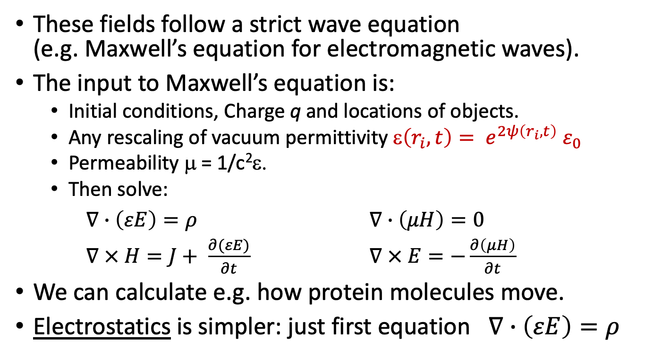
Electromagnetic fields
These fields follow a strict wave equation
(e.g. Maxwell’s equation for electromagnetic waves).
The input to Maxwell’s equation is:
  Initial conditions, Charge q and locations of objects.
  Any rescaling of vacuum permittivity ε$\left(r_{i},t\right)= e^{2ψ\left(r_{i},t\right)}{ ε}_{0}$
  Permeability μ = 1/c²ε.
  Then solve:
$∇∙\left(εE\right)=ρ$ $∇∙\left(μH\right)=0$
$∇ × H=J+ \frac{∂(εE)}{∂t}$ $∇ × E=−\frac{∂\left(μH\right)}{∂t}$
We can calculate e.g. how protein molecules move.
Electrostatics is simpler: just first equation $∇∙\left(εE\right)=ρ$

Slide 22
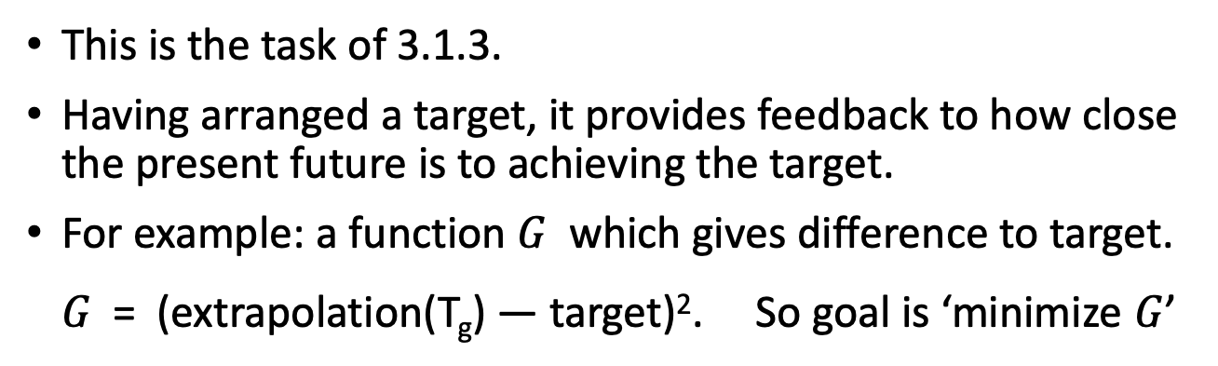
(c) A measure of goal mismatch (discrimination)
3. |  | Principles | Propagating causes | Effects
3.1 |  | 3.1.1 Reception of targets | 3.1.2 Causes to arrange targets | 3.1.3 Arranged specific targets
3.2 |  | 3.2.1 Lagrangian: Principles for quantum fields | 3.2.2 Propagation of quantum fields for all future options | 3.2.3 Results of quantum fields
3.3 |  | 3.3.1 Hamiltonian: kinetic + potential energies | 3.3.2 Quantum wave function | 3.3.3 Actual selections e.g. Measurements
This is the task of 3.1.3.
Having arranged a target, it provides feedback to how close the present future is to achieving the target.
For example: a function $G$ which gives difference to target.
$G$ = (extrapolation(T_{g}) — target)². So goal is ‘minimize $G$’

Slide 23
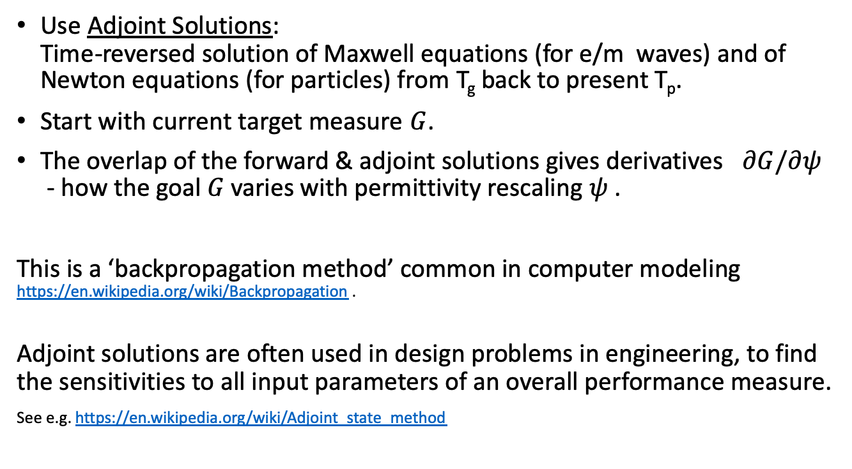
(d) A way to work on mismatch, thinking back to present
Use Adjoint Solutions:
Time-reversed solution of Maxwell equations (for e/m waves) and of Newton equations (for particles) from T_{g} back to present T_{p}.
Start with current target measure $G$.
The overlap of the forward & adjoint solutions gives derivatives $∂G/∂ψ$
- how the goal $G$ varies with permittivity rescaling $ψ$ .
This is a ‘backpropagation method’ common in computer modeling https://en.wikipedia.org/wiki/Backpropagation .
Adjoint solutions are often used in design problems in engineering, to find the sensitivities to all input parameters of an overall performance measure.
See e.g. https://en.wikipedia.org/wiki/Adjoint_state_method

Slide 24
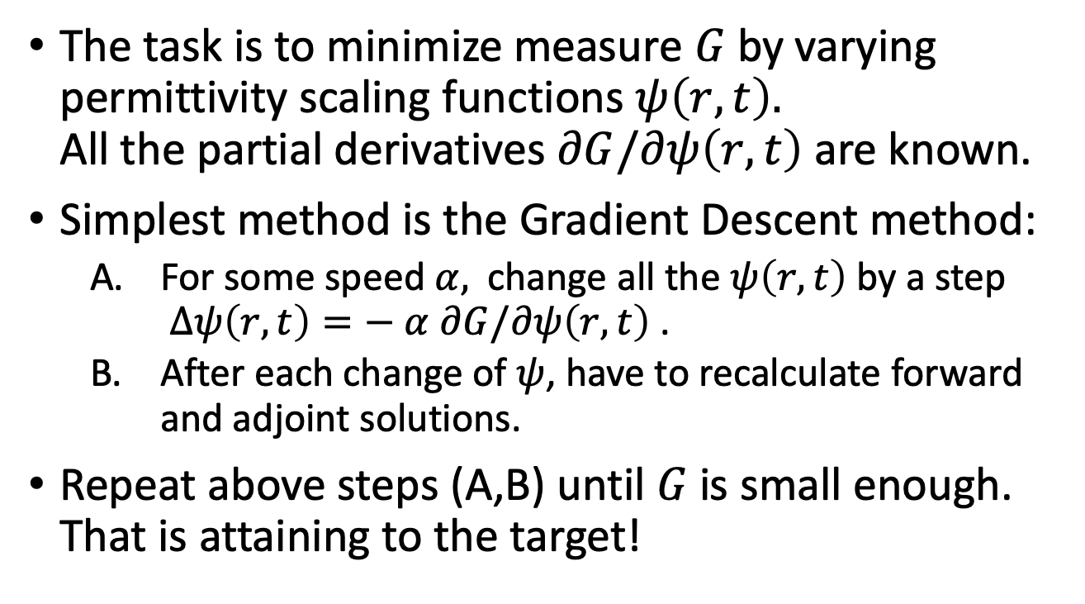
(e) A way to find changes to causes to reduce the mismatch G.
The task is to minimize measure $G$ by varying permittivity scaling functions $ψ\left(r,t\right).$
All the partial derivatives $∂G/∂ψ\left(r,t\right)$ are known.
Simplest method is the Gradient Descent method:
  For some speed $α,$ change all the $ψ\left(r,t\right)$ by a step
  $∆ψ\left(r,t\right)=− α ∂G/∂ψ\left(r,t\right)$ .
  After each change of $ψ$, have to recalculate forward and adjoint solutions.
Repeat above steps (A,B) until $G$ is small enough.
That is attaining to the target!

Slide 25
4. Numerical Demonstrations

Slide 26
Calculating Effects of Formal Causes
(Influx from 3.1 degree into 3.2 degree)
Backpropagation to reach Targets by Varying Charges
Numerical Examples of schematic Protein Folding
using Molecular Dynamics models

Slide 27
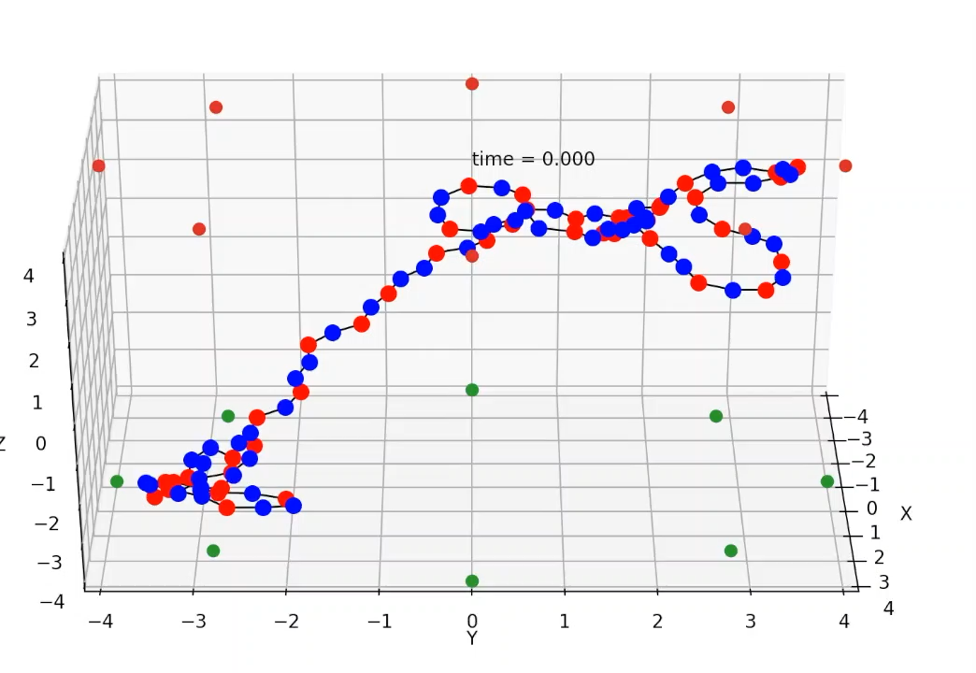
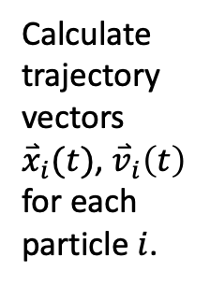
Demonstration using 100 particles inside a cage of 2 rings, 16 charges
A molecule
put in a
smaller
cage.
Calculate
trajectory
vectors
${\overset{⃑}{x}}_{i}(t)$, ${\overset{⃑}{v}}_{i}\left(t\right)$
for each
particle $i$.
Units
Time:
ps = 10⁻¹² s
Space:
nm = 10⁻⁹ m
Blue: +0.2e charge. Red: -0.2e charge (e=unit charge).
Cage charges are -3e, like GroEL chaperone molecule
Bond lengths and angles specified.
Repulsive cage wall. No water

Slide 28
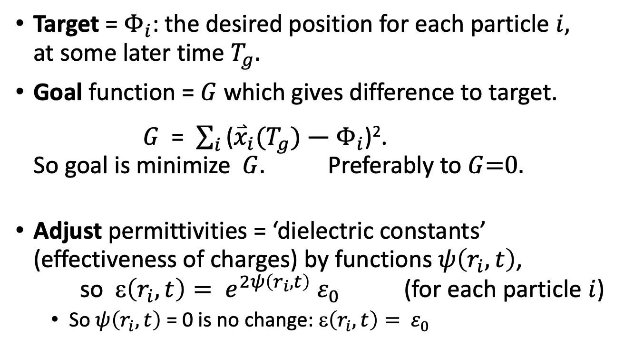
Targets and Adjustments
Target = $Φ_{i}$: the desired position for each particle $i,$
at some later time $T_{g}.$
Goal function = $G$ which gives difference to target.
$G$ = $\sum_{i}{\text{(}{\overset{⃑}{x}}_{i}(T_{g})\text{ — }Φ_{i}\text{)}\text{2}}$.
So goal is minimize$G$. Preferably to $G$=0.
Adjust permittivities = ‘dielectric constants’ (effectiveness of charges) by functions $ψ\left(r_{i},t\right)$,
so ε$\left(r_{i},t\right)= e^{2ψ\left(r_{i},t\right)}{ ε}_{0}$ (for each particle $i$)
  So $ψ\left(r_{i},t\right)$ = 0 is no change: ε$\left(r_{i},t\right)= { ε}_{0}$
Done with 3700 lines of Python, with Cython to compile C kernels.

Slide 29
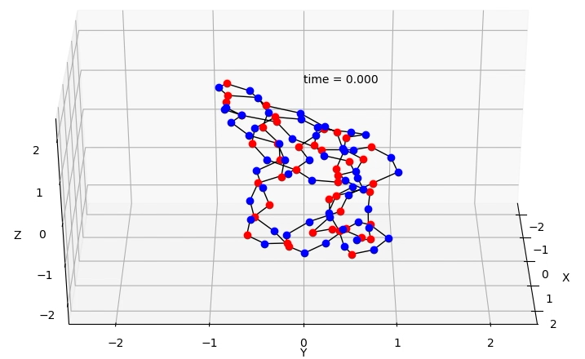
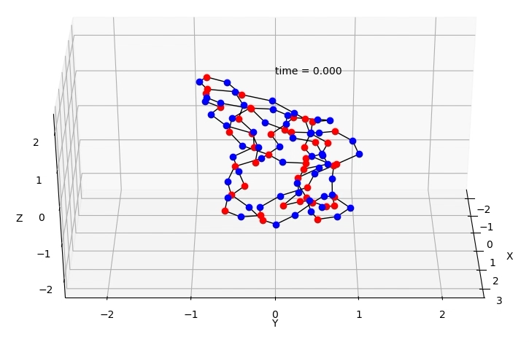
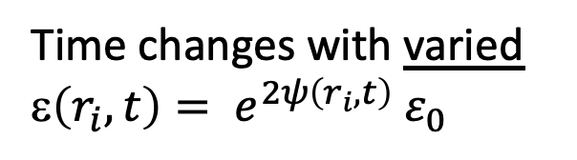
Demonstration 1:
Shifting centroid to the left by 1 nm
Time changes with varied ε$\left(r_{i},t\right)= e^{2ψ\left(r_{i},t\right)}{ ε}_{0}$
Normal time changes

Slide 30
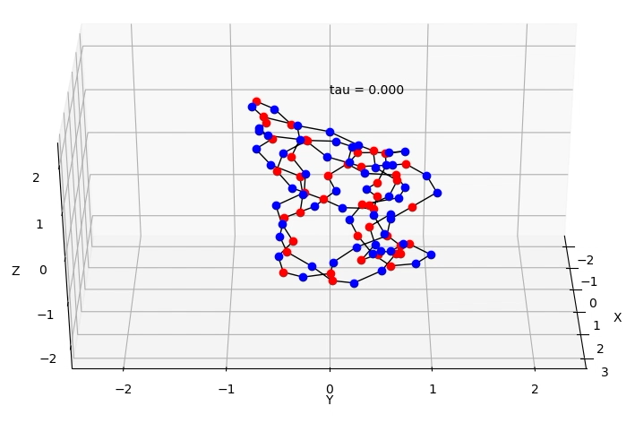
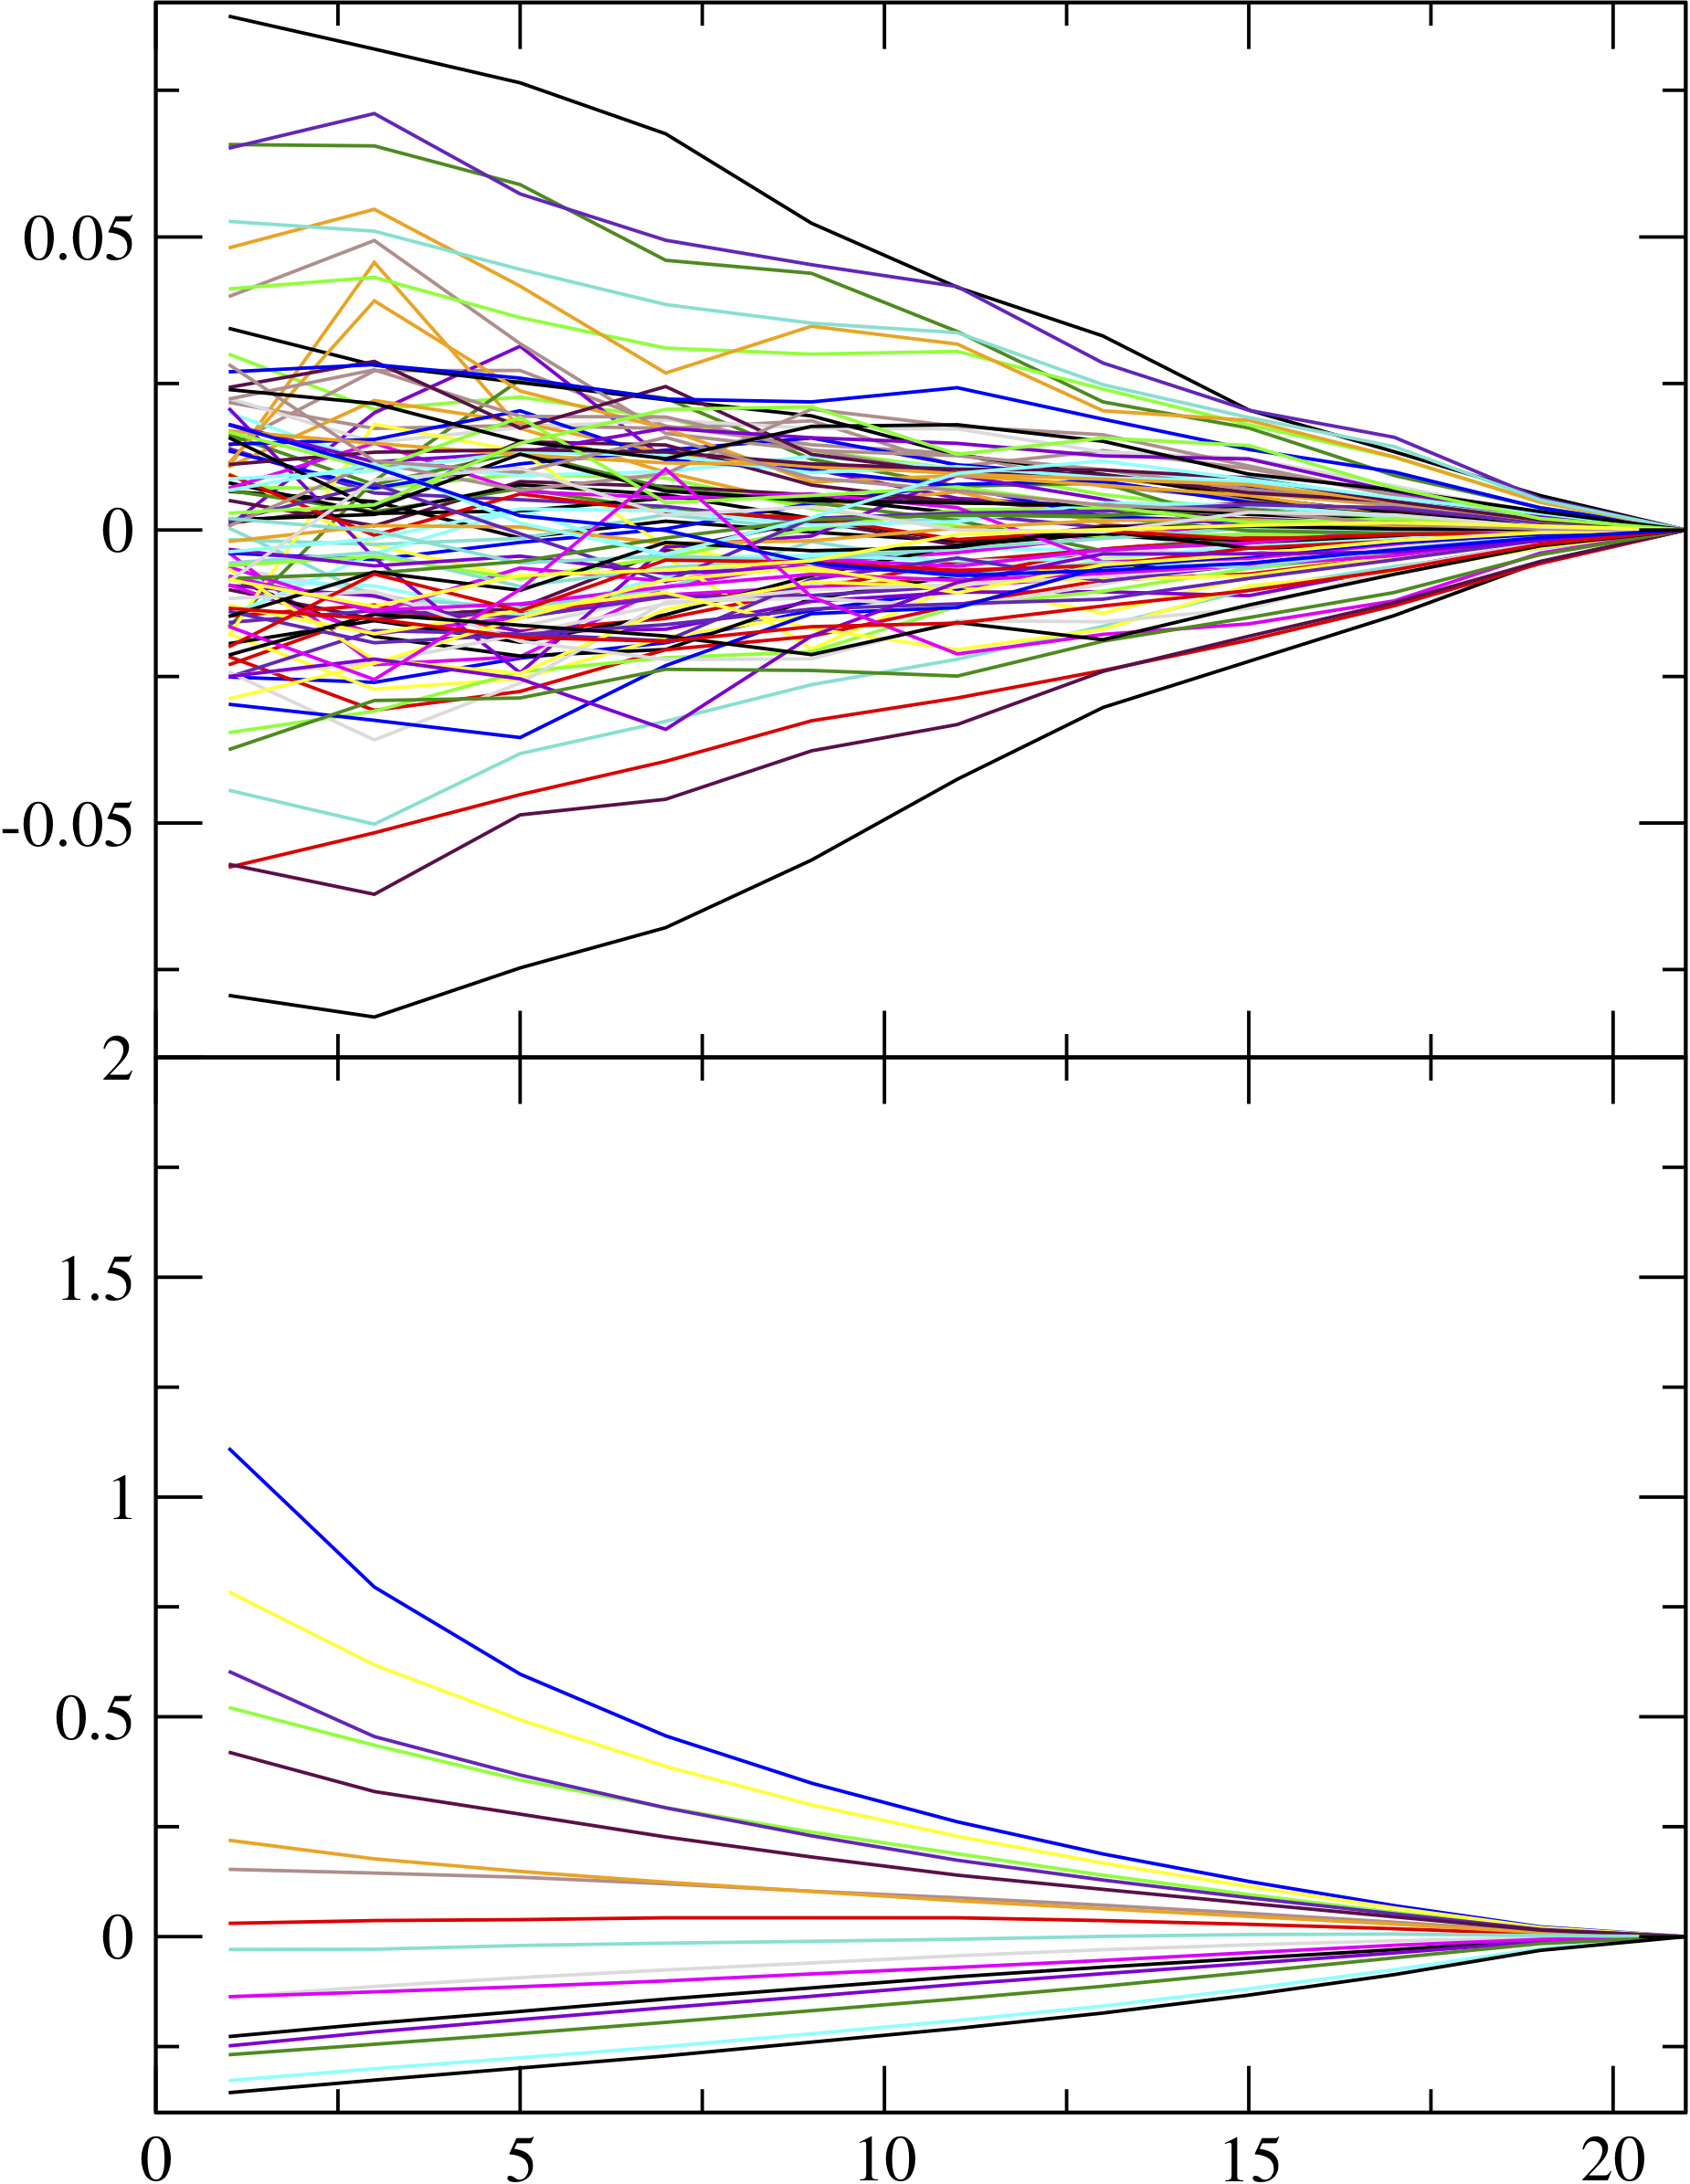
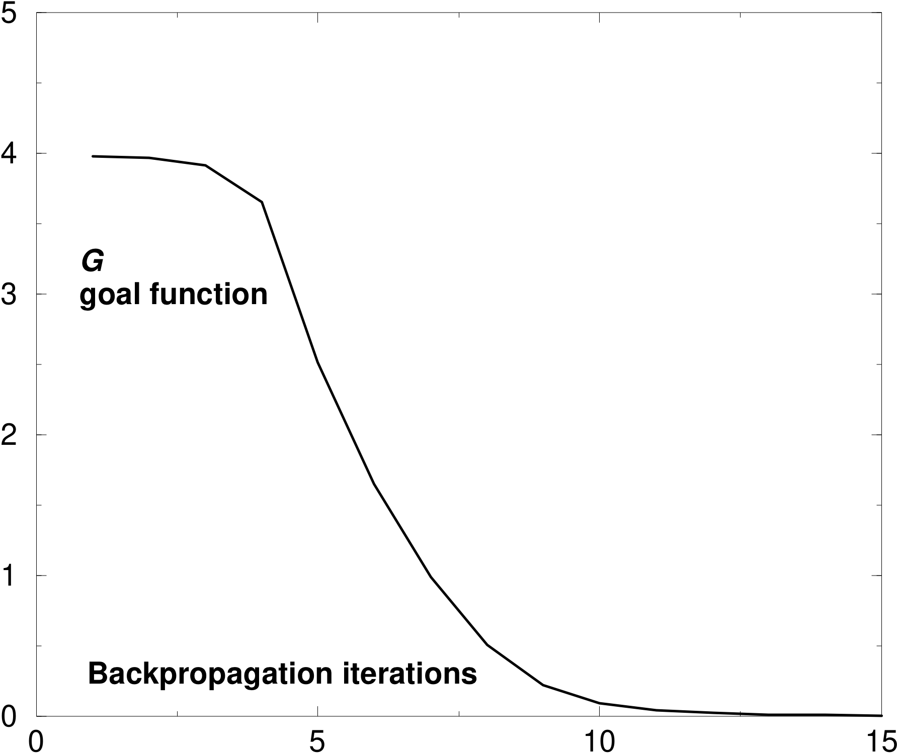

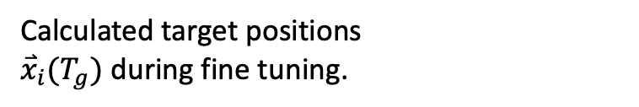
Demonstration 1: Shifting left.
How?
Calculated target positions
${\overset{⃑}{x}}_{i}(T_{g})$ during fine tuning.
Variations $ψ\left(r_{i},t\right)$ when converged to $G$=0
Variation in molecule charges
Variation in cage charges
A few have large increases

Slide 31
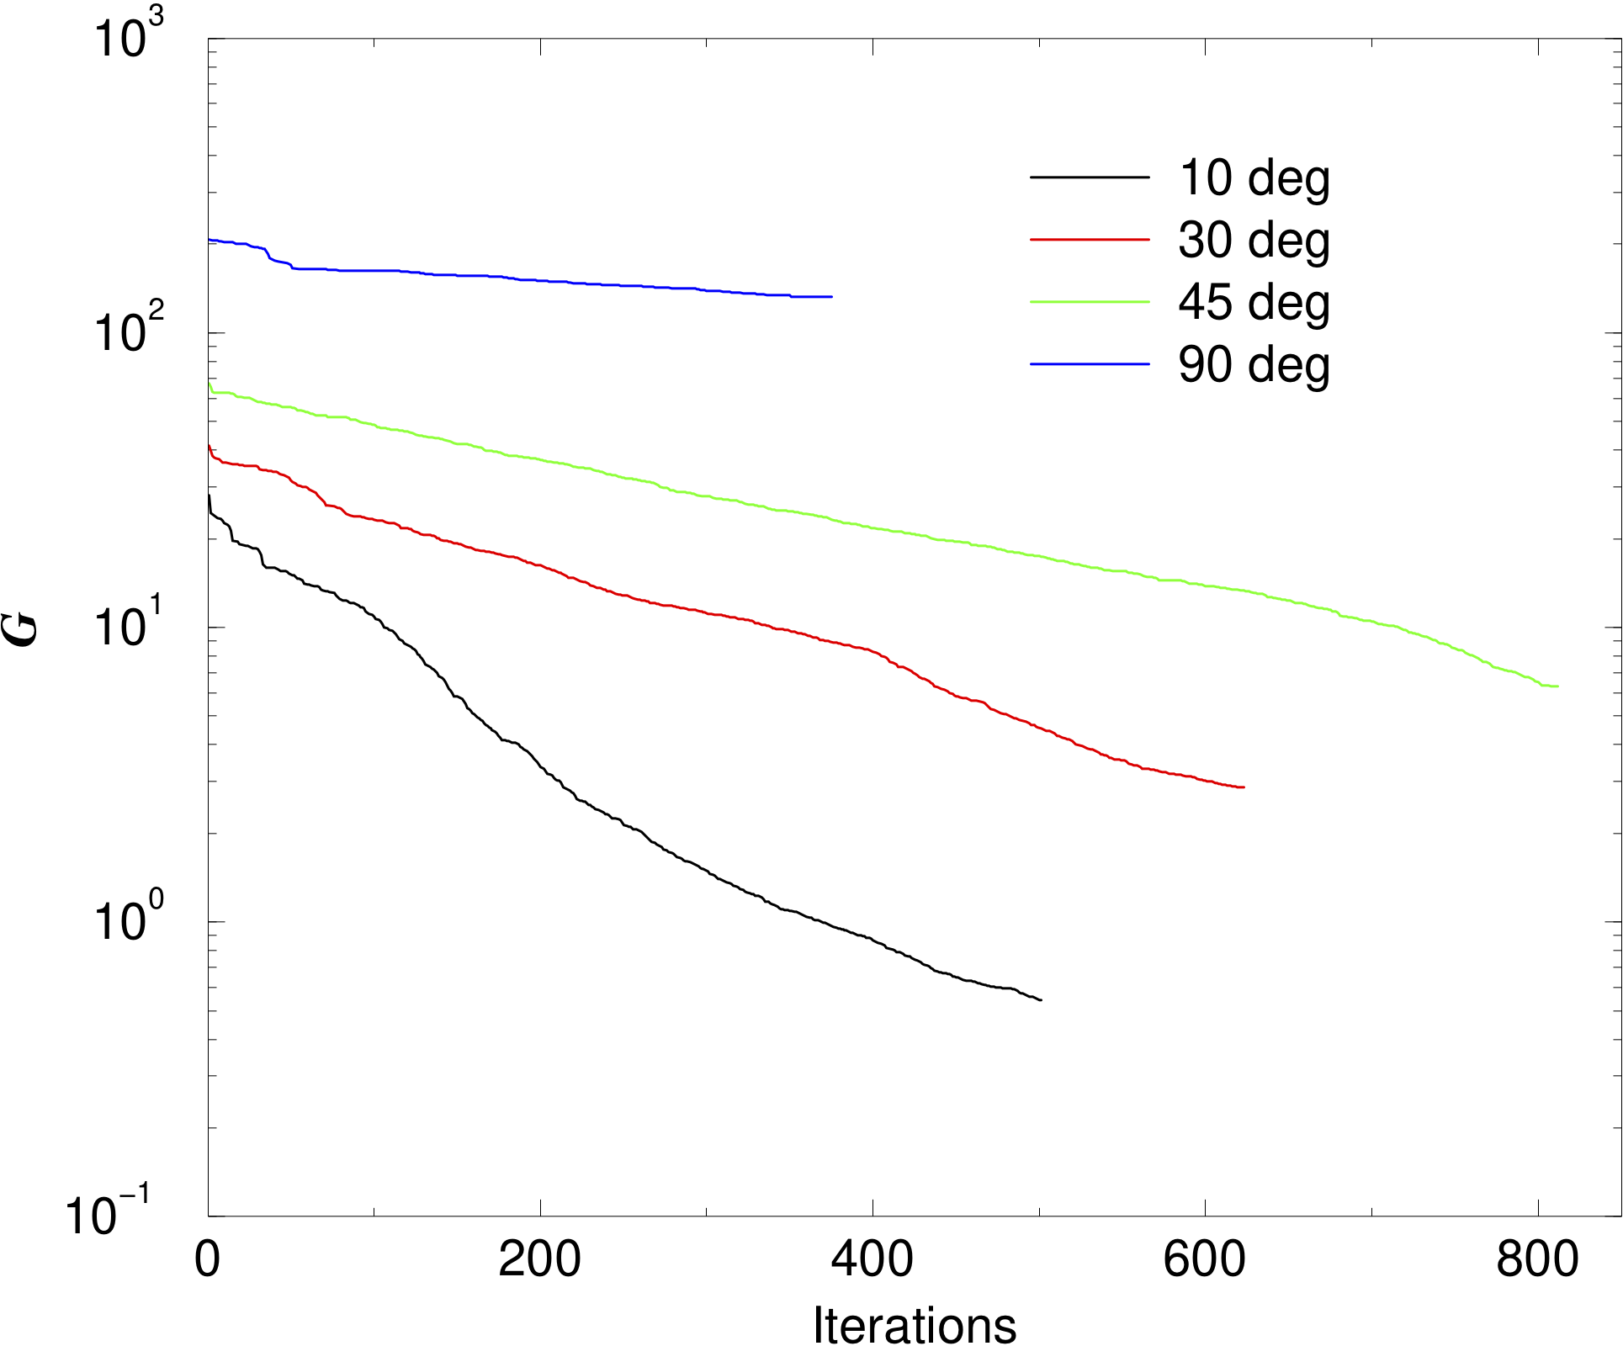

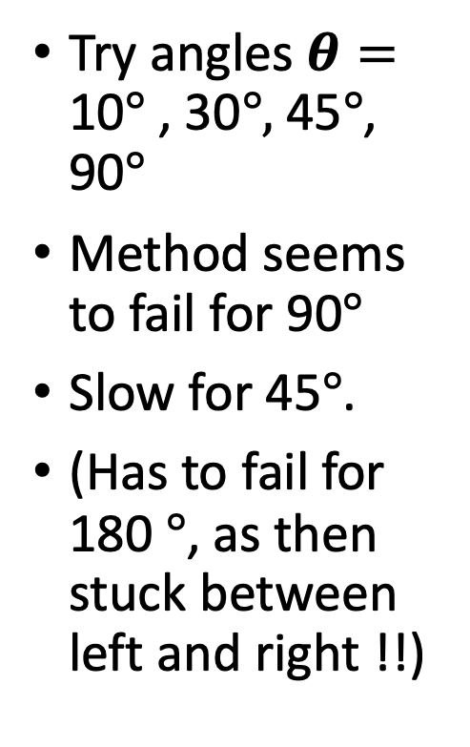

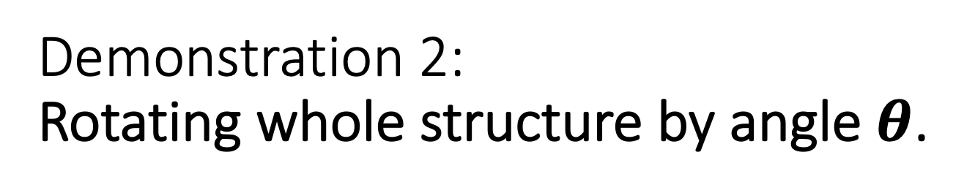


Demonstration 2:
Rotating whole structure by angle $θ$.
Try angles $θ=$ 10$°$ , 30$°,$45$°$, 90$°$
Method seems to fail for 90$°$
Slow for 45$°$.
(Has to fail for 180 $°$, as then stuck between left and right !!)
Convergence is slower for large angles:
90 $°$
45 $°$
30 $°$
10 $°$

Slide 32
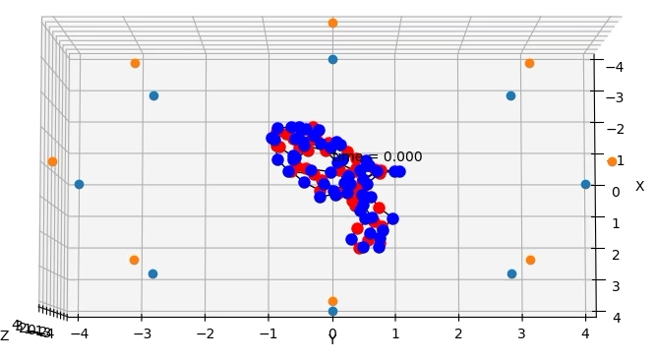
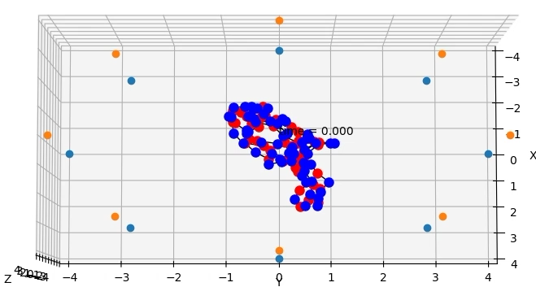
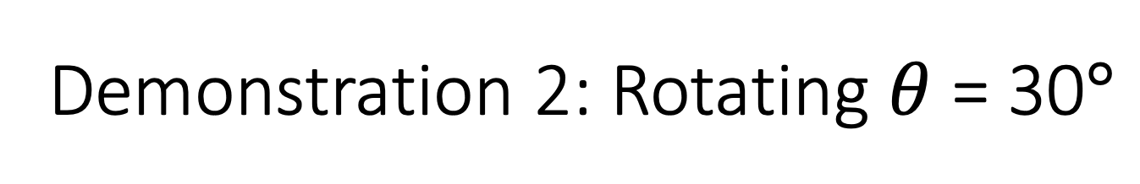
Demonstration 2: Rotating $θ$ = 30$°$
Normal time changes
Time changes with varied ε$\left(r_{i},t\right)= e^{2ψ\left(r_{i},t\right)}{ ε}_{0}$
Note some changes to internal structures at end.

Slide 33
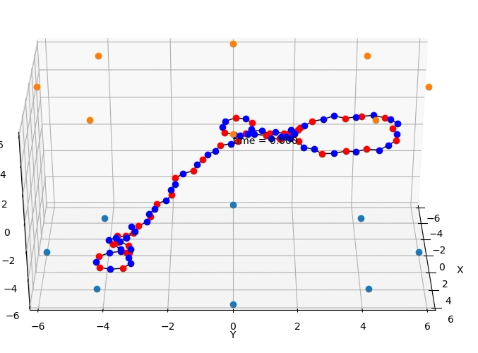
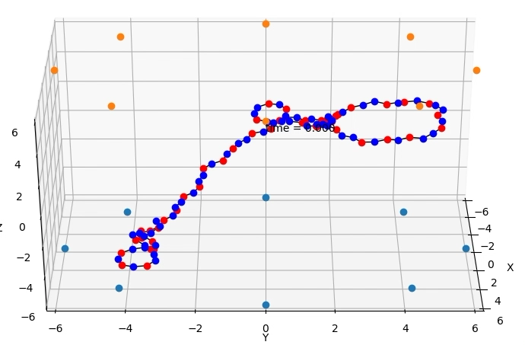
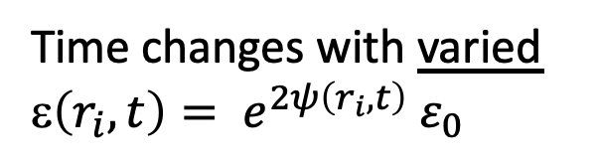
Demonstration 3
Reshaping part of a molecule
Target: shape with a dent in the upper loop
Normal time changes
Time changes with varied ε$\left(r_{i},t\right)= e^{2ψ\left(r_{i},t\right)}{ ε}_{0}$

Slide 34
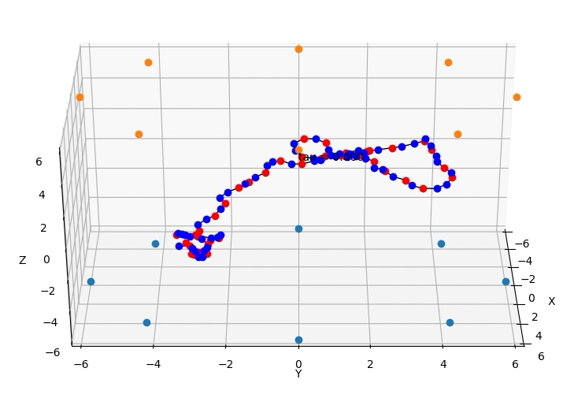
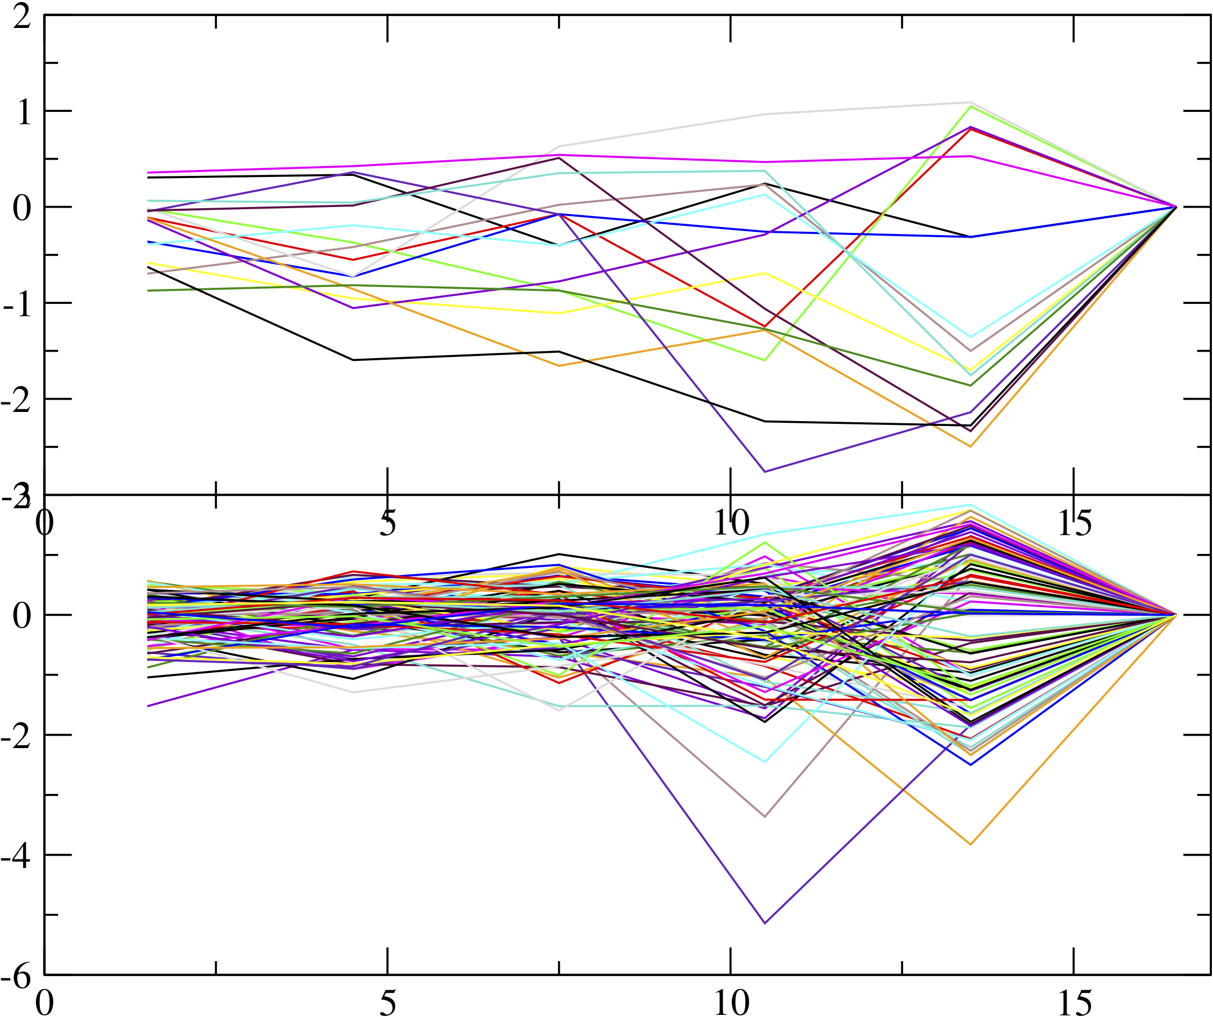
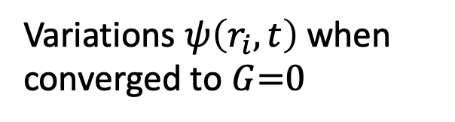
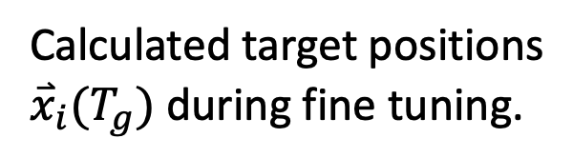
Demonstration 3: Reshaping.
How?
Variation in cage charges
Variation in molecule charges
Calculated target positions
${\overset{⃑}{x}}_{i}(T_{g})$ during fine tuning.
Variations $ψ\left(r_{i},t\right)$ when converged to $G$=0

Slide 35
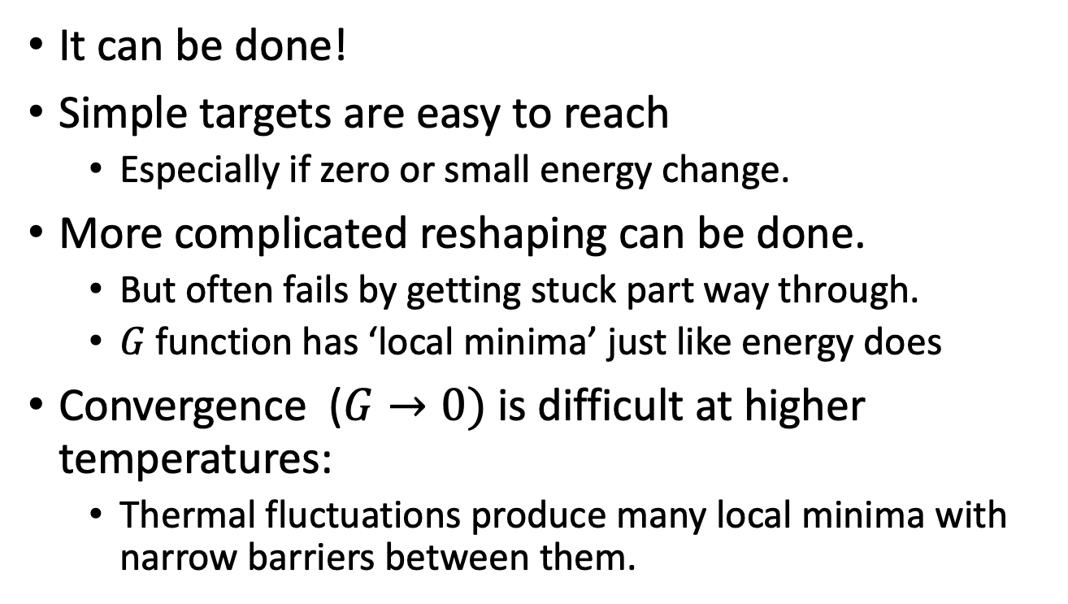
My ‘Observations’
It can be done!
Simple targets are easy to reach
  Especially if zero or small energy change.
More complicated reshaping can be done.
  But often fails by getting stuck part way through.
  $G$function has ‘local minima’ just like energy does
Convergence ($G→0)$is difficult at higher temperatures:
  Thermal fluctuations produce many local minima with narrow barriers between them.

Slide 36
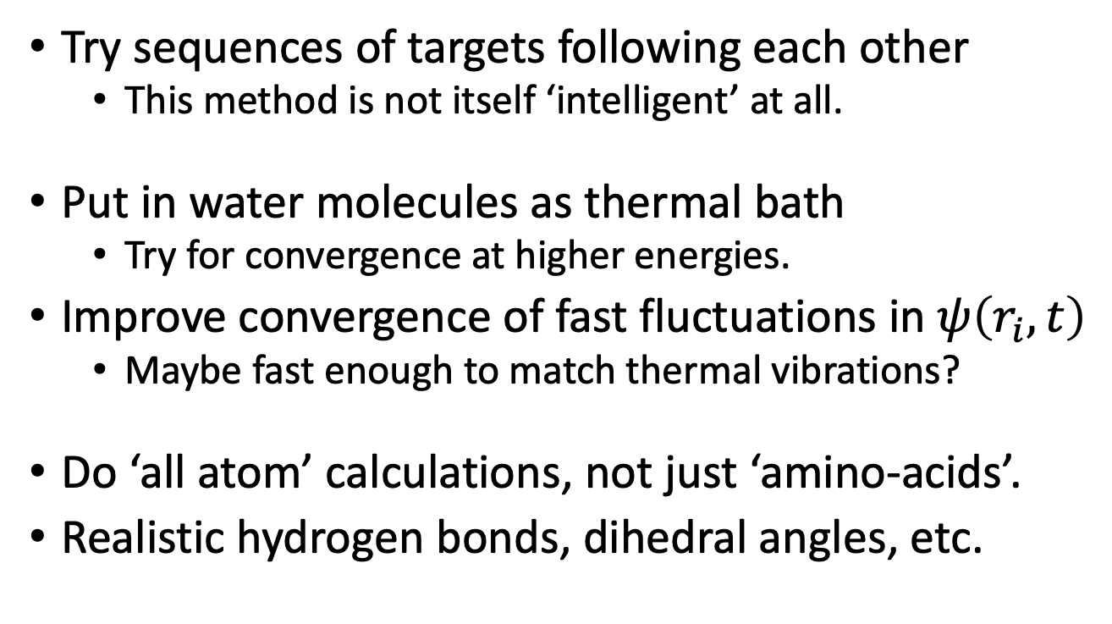
Improved calculations next:
Try sequences of targets following each other
  This method is not itself ‘intelligent’ at all.
Put in water molecules as thermal bath
  Try for convergence at higher energies.
Improve convergence of fast fluctuations in $ψ\left(r_{i},t\right)$
  Maybe fast enough to match thermal vibrations?
Do ‘all atom’ calculations, not just ‘amino-acids’.
Realistic hydrogen bonds, dihedral angles, etc.

Slide 37
Summary of overall answers:
We can propose two hypotheses to answer our questions:
WHAT influx changes in physics?
Answer: The relative permittivity of the vacuum
HOW influx changes could be used in physics?
Answer: For target configurations given by influx into the natural, there is a physical feedback mechanism to bring physical objects closer to this target in the near future.

Slide 38
What have we done? (or, tried to do!)
Made a proposal for how ‘spiritual influx’ could have effects in nature.
These effects on permittivity should be measurable
This way, ‘final causes’ could be active in nature.
We have a way to bring the future into line, without time travel, and without altering the historical past.
No longer is the physical universe ‘causally closed’.
A much greater range of scientific explanations should be possible.

Slide 39
THE END
Thanks to the Theistic Science group!
  Many discussions over the last two years.
Ron Horvath, Stephen Smith, Andy Heilman, Reuben Bell, Forest Dristy, Gard Perry,
and others.

