Slide 1
From Triads to Enneads
(3)
(9)
… and connecting with modern physics.
Ian Thompson
www.ianthompson.org

Slide 2
Love-Wisdom-Use
A common pattern of influx: from Swedenborg
It can be seen in many places, spiritual & natural:
Spirit, mind and nature.
Celestial, Spiritual and Spiritual-natural heavens – in spiritual.
Loving, thinking, and acting – in mind (mental)
Principles, causes and events – in natural physics.
Each of these has love-wisdom-use within itself
DLW 79: “Divine is the same in things greatest and least”. Each reacts according to its nature.

Slide 3
So: Triad(3) → Ennead(9)
1. Love | 2. Wisdom | 3. Use
3
1.1 Love for love itself | 2.1 Wisdom about love | 3.1 Use from love
1.2 Love for wisdom | 2.2 Wisdom about wisdom | 3.2 Use from wisdom
1.3 Love for use | 2.3 Wisdom about use | 3.3 Use as use itself.
9
Internal mind (spirit) | External mind (every day) | Natural world
Degrees and sub-degrees. And sub-sub-degrees too!
All of these sub/degrees are related by influx:
Downward/rightward production
selected according to previous actions.
Influx produces correspondences between structures and functions.

Slide 4
Natural sub-degrees. Should be related to physics!
3.1 Use from love
3.2 Use from wisdom
3.3 Use from use
But no longer spiritual, but in nature (natural)
.
Swedenborg
So let us rename more as ‘natural’:
3.1 Action from ends | Gravity
3.2 Action from form | Magnetism
3.3 Ultimate action | Air
Swedenborg LJP 320:
The three natural atmospheres arising from the sun of the world are
the purer ether, which is the universal atmosphere, from which springs all gravity;
the intermediate ether, which forms a vortex around the planets and surrounds the moon and other satellites, from which springs magnetism; and
the lowest ether, which is air.

Slide 5
Relation to quantum physics!
So let us rename more as ‘natural’:
3.1 Action from ends | Making spacetime and its ends
3.2 Action from form | Electromagnetic and quantum fields
3.3 Ultimate action | Physics of objects (quantum & classical)
Let us separate ‘making spacetime’ (by immediate influx)
from the individual ‘ends’ that come by mediated influx through created spirits.
Influx into nature
Swedenborg AC 7270[4]:
God's truth, which flows into the third heaven nearest to the Lord, at the same time flows right down into the last and lowest degrees of order as well, without undergoing consecutive degrees of formation.
Every single thing at that level is also directly governed and provided by Him who is the First.
In this way the consecutive degrees are held together in their proper order and connection.

Slide 6
Immediate and Mediate Influx
The Divine
Divine Influx
Divine Influx
Immediate = first step
Mediated = later step
immediate
Immediate
1. Spiritual Beings in Grand Man
2. Our mind
AC 5850
they receive particular influx; that is, there are with them angels and spirits through whom the influx comes.
Mediated?
(particular)
(setting up the framework to receive mediated influx)
Physical things
(ultimates)
3.1: Targets
3.2: Fields
3.3: Particles

Slide 7
Sub-sub-degrees too!
3.1 Action from ends | Making spacetime and its ends
3.2 Action from form | Electromagnetic and quantum fields
3.3 Ultimate action | Physics of objects (quantum & classical)
Previous:
From DLW 79: “Divine is the same in things greatest and least”, expect sub-sub-degrees of all of these:
3. |  | Principles | Propagating causes | Effects
3.1 |  | 3.1.1 Reception of targets | 3.1.2 Causes to arrange targets | 3.1.3 Arranged specific targets
3.2 |  | 3.2.1 Lagrangian: Principles for quantum fields | 3.2.2 Propagation of quantum fields for all future options | 3.2.3 Results of quantum fields
3.3 |  | 3.3.1 Hamiltonian: kinetic + potential energies | 3.3.2 Quantum wave function | 3.3.3 Actual selections e.g. Measurements
3.3 = ordinary quantum mechanics. 3.2 = quantum field theory. 3.1 = ? unknown

Slide 8
Quantum physics we understand
3.1 Action from ends
3.2 Action from form
3.3 Ultimate action
3.2 degree is physics of electromagnetic fields
Also gluon fields
Generates forces that act between 3.3 individual objects
By principles of “Quantum Field Theory” (QFT)
Determined by ’Lagrangian’ with given couplings constants.
3.3 degree is physics of individual objects
Molecules, atoms, nuclei, quarks, etc.
Seemingly well understood:
By wave functions in quantum physics.
By forces on masses in classical physics.
‘Measurement problem’ still a puzzle. But only small effects.

Slide 9
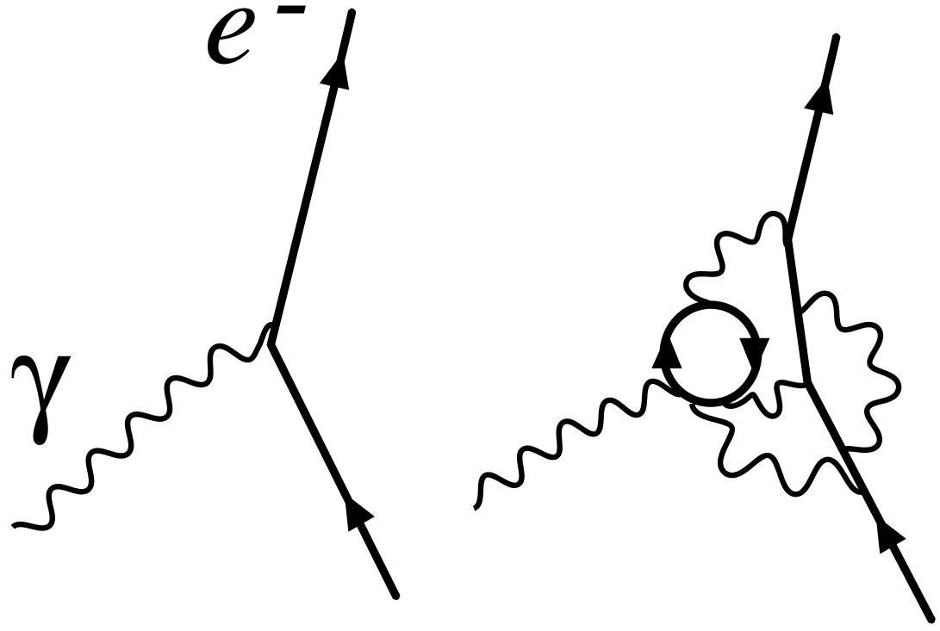
A difference between 3.2 and 3.3: ‘bare’ and ‘dressed’ interactions
3.2.1 Lagrangian: Principles for quantum fields | 3.2.3 Virtual events
3.3.1 Hamiltonian: kinetic + potential energies | 3.3.3 Actual events
There are input masses, charges
3.2.1/QFT uses ‘bare interactions’
3.3.1/QM uses ‘dressed interactions’: combined effects of all possible events.
QFT gives the result of calculations for QM: must give measured mass & charge.
3.2:
Individual
events
‘bare’.
3.2 for 3.3:
Complex
Events
‘dressed’.
‘Dressing’ changes the total
strength of the interaction:
charge is effectively changed.
Need to adjust bare interactions so dressed charge agrees with experiment.

Slide 10
‘Renormalization’: an issue in QFT
Question! How do we ‘adjust’? How do we know what ‘bare charge’ to put in Lagrangian in 3.2.1 in order to get the correct ‘dressed charge’ in 3.3.1?
‘Renormalization’: method invented in QFT: (a) Do calculation is at fixed resolution. (b) Vary bare parameters to get physical dressed as in expt
This seems to work remarkably well! Results found to be not sensitive to the chosen ‘fixed’ resolution as long as it was fine enough. Very accurate predictions made and seen in experiments.
But Nature has to use with fixed inputs, even if fluctuations at the finest level (e.g at Planck length). How could it work?
Maybe there ’fine tuning’ which adjusts inputs to give the regularly observed outputs?

Slide 11
Physics we do not understand
3.1 Action from ends
3.2 Action from form
3.3 Ultimate action
3.1 degree of gravity ??
Big debate for last 90 years on how to link the gravity of Einstein’s “General Relativity” with quantum physics.
Can we formulate ‘quantum gravity’? No luck so far.
Still no explanation for the very low vacuum energy density
3.1 degree for ‘fine tuning’ parameters in QFT ??
QFT does not deliver ‘out of the box’, input values adjustable:
“Renormalized parameters” have to be fine-tuned to observed values, to fix:
Higgs mass (a hard problem)
Quark masses, electron mass, unit charge (a bit easier)
3.1 linking the spiritual with the natural ??
No-one trying that yet ! Should we try? After lunch.

