Slide 1
Protein Synthesis and “Fine Tuning”
Paradigms for the discrete degrees of Divine influx
Stephen H. Smith, MD
Notes:
I thank my Colleagues in the Theistic Science group for their suggestions and ideas which have contributed greatly to this presentation. Ian Thompson in particular deserves credit for introducing the topic of Protein Folding to the group and since its introduction it’s been a source for active exploration and much lively discussion.
Much thanks also to Lisa Childs for her hard work and skills in organizing this Symposium
Without the help of my sister Suzy Laidlaw I never would have been able to do this PowerPoint…she cleaned it up, made it pretty, and gave me invaluable advice

Slide 2
“Proteins are subtle and delicate things…”
Notes:
The four classes of organic molecules, common to all forms of life, both in the animal and plant kingdoms are NUCLEIC ACIDS, CARBOHYDRATES, LIPIDS, AND PROTEINS. All proteins are folded polypeptide chains but not all polypeptides are proteins. A polypeptide chain is a string of amino acids connected by peptide bonds, usually between 100 and 500 in number but some can be several thousand amino acid bases long.
It is because proteins are such “subtle and delicate things” that the exploration of their synthesis, using an overlay of New Church doctrine as a guide, might yield some insight into the nexus of Divine influx as it passses from the spiritual world into the natural world!

Slide 3
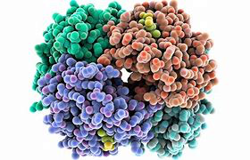
Notes:
1. Estimated to be at least 80 million different proteins in the world.
2. Somewhere between 50 and 100,000 thousand different proteins in the human body.
3. This image represents a fully folded globular protein, perhaps and enzyme, with the different colors representing domains or subunits.

Slide 4
Functions of Proteins
Enzymes
Signaling
Structural
Transport
Regulatory
Storage
Immunity
Notes:
Enzymes are catalysts driving biochemical reactions at a rate about a billion times faster than would occur without them.
Signaling proteins include growth factors, hormones, and neurotransmitters
Structural proteins: Actin, tubulin, capsid of viral particles, elastin, collagen in skin, tendons, bone
Transport proteins carry molecules across membranes.
Regulatory proteins troponin and tropomyosin in muscle and proteins that regulate the transcription of DNA
Storage proteins serve as biological reserves of metal ions and amino acids.
Immunity proteins include antibodies and complement proteins

Slide 5
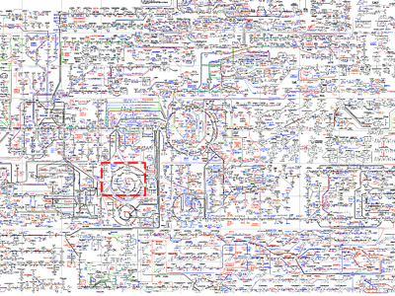
Slide 5
Notes:
1. One of three Metabolic pathway charts courtesy of Roche Pharmaceutical Co. The majority of the labels represent a different enzyme catalyzing a specific reaction.

Slide 6
Why look at Protein Folding?
Forces at work operate at the atomic level
Apparent causes (forces) in nature correspond to spiritual qualities
Influx “fine tunes” by effects on the electric charge
Notes:
Short answer: Because it’s a mystery and in fact it’s such a profound mystery that it takes on mystical qualities. And things mystical embedded in good science are of great interest to this group.

Slide 7
“Understanding the spiritual cascade of discrete degrees behind the physical degree of life may be a framework that is useful to better understand what is still unknown about protein structure, function and synthesis
Ian Thompson, PhD
Notes:
.We think that a fuller understanding of the discrete degrees of Divine influx can lead to major breakthroughs in science, not just in the complex and beautiful story of protein folding but in all areas of science!

Slide 8
Three Approaches to the Study of Protein Synthesis
In Vivo (within a living cell)
In Vitro (in a test tube))
In Silico (computational)
Notes:
Studying protein synthesis within the living cell itself is difficult as the cell is so small, fragile, and densely packed with hundreds of different proteins
Current methods of in vitro investigation generally involve isolating a specific protein, and sometimes denaturing it with strong agents to vary the pH or by raising the temperature. Other sophisticated processes such as X-ray crystallography, NMR spectroscopy, FRET (fluorescence resonance energy transfer) or FTIR (Fourier transform infrared spectroscopy) are often used
In silico means” computational” and the programs used seem to use protein stabilization parameters to draw inferences regarding synthesis more than folding itself.

Slide 9
Beginning of Modern Protein Science
19th century brewing and baking
Pasteur’s discoveries
Pasteur vs Liebig Traube
Notes:
Modern protein science began with the discovery of enzymes, originally called “ferments” and this was driven by the industrialization of brewing, and baking both of which are derived from alcoholic fermentation.
Pasteur, in papers published in 1858, describes for the first time the process of metabolism in yeast, a living cell, and persists in his belief if vitalism, that a living cell was required to drive the process of fermentation.
Liebig insisted that there were non-living products derived from the decomposing yeast cells that produced fermentation. He discovered that treating casein with acid released leucine and tyrosine. Leucine had been identified a quarter century earlier but tyrosine was new.
In 1860 Moritz Traube proposed that substances analogous to the known soluble ferments existing inside living cells were responsible for carrying out alcoholic fermentation.
The present list of amino acids was not completed until 1935.

Slide 10
“Anfinsen’s Dogma”
The sequence of amino acids in the primary polypeptide chain determines the final folded tertiary form and, therefore, its function.
Notes:
Christian Anfinsen and two colleagues shared in the 1972 Nobel Prize in chemistry for In vitro experiments using denaturants
Demonstrating that “…the bonding capacities of the amino acids as they occur in the linear polypeptide chain are sufficient to fold a newly synthesized amino acid chain into an architecturally complex and biologically active protein.” I.E. The sequence of the amino acids determines the form and function of the protein.

Slide 11
What Determines the Amino Acid Sequence?
DNA mRNA
Ribosome
tRNA
Notes:
1. The DNA in every cell contains a gigabyte of information in an arrangement a trillion times more dense than any computer hard drive. Groups of three neucleotides in the DNA molecule form a codon and each codon transfers the information to messenger RNA for the addition of a specific amino acid by transfer RNA to the growing chain in the ribosome.

Slide 13
Stages In The Formation Of Proteins
Primary = polypeptide chain
Secondary = alpha helix and beta sheets
Tertiary = “native”, active, fully folded form
Quaternary = combination of two or more discrete polypeptide chains
Notes:
When a protein is being synthesized within the ribosome amino acids are linked by peptide bonds to form a simple chain, like a string of beads. This is called the primary form.
Folding of the primary form may begin within the ribosome as it is being extruded and this is termed “co-translational” folding. The secondary stages, are known as alpha helices, beta turns and beta sheets. These frequently join to become barrel shaped structures.
Finally the active, native or tertiary form results from a “complex balance of short range interactions which determine the intrinsic conformational preferences of the amino acids, medium
range interactions, particularly those stabilizing regions of the secondary structure, and non-local tertiary interactions which determine the global fold of the protein” (from a review paper “The concept of a random coil Residual structure in pepetides and denatured proteins by Smith, Feibig, Schwalbe, and Dobson.

Slide 16
Discrete Degrees
The end (goal) is contained within the cause the cause and the end are contained in the effect.

Slide 17
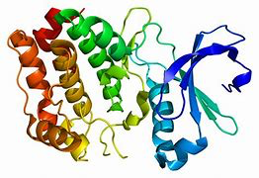

Slide 18
“Levinthal’s Paradox”
With only 100 amino acids
Trial fold once every ten trillionth of a second
10⁸¹ years to fold successfully
Yet protein folding takes only a second!
Notes:
1.A polypeptide chain of only 100 amino acid residues, making “random searches” for the correct conformation, at the rate of one trial fold every ten trillionth of a second, would require 10⁸¹ years to successfully fold…yet proteins typically fold very quickly in 1/10⁶ sec to several seconds.
2. Genesis Chapter 27 verse 19: Jacob pretending to be Esau “Arise I pray thee, sit, and eat of my hunting...Verse 20 “How is it that thou hast so quickly found it, my son?” AC 3555 Says that “this signifies production so speedy, is evident without explication.” “Verse 20 “..Because Jehovah thy God caused it to fall to me” AC 3556: “... signifies providence, may be evident without explication”.

Slide 19
Many Attempts to Solve Levinthal’s Paradox
“Bias” in the pathways? Yet from whence cometh the “bias”?
“Funnel” energy landscape???

Slide 20
Landscape “Funnel”
Notes:
The advantage of this hypothesis is that it’s simple but as researchers Melkikh and Meijer point out it violates the physical and topological constraints
The assumption is that somehow there in an intrinsic knowledge in the folding process that one conformation rather than another is the proper one, in other words there is an ulta super computer near or within the polypeptide chain with a sophisticated software program telling the folding process which fold is proceeding toward the desired goal of a useful native form.

Slide 21
The Protein Folding Problem
A new distinct branch of science: utilizing chemistry, biology, and physics (both classical and quantum physics).
And now, for the first time theology!
Notes:
1. Why theology? Because the entire process can only be explained by Divine Providence and Divine influx

Slide 22
Key Theological Principle:
Causes are spiritual, they only appear to be from nature!
Slide 22

Slide 23
Key Theological Principle:
All forms tend toward the human (form).

Slide 25
Competing Theories of Protein Folding
Thermodynamics: Gibb’s Free Energy
Place different emphasis on hydrophobic-hydrophilic models
Research is largely computational
and increasingly statistical
Notes:
1. Possible avenues of influx that affect the bonds and conformations that determine the very precise structure that constitutes a useful protein molecule.
2. By examining the unique set of forces that fold and stabilize a protein, correspondences to distinct spiritual qualities relating to use seem to emerge.
3. The theory that explores the most fundamental forces, i.e. quantum forces will be the most useful for our purposes.

Slide 26
Protein Folding - from a Theistic Science Perspective
Forces and interactions that fold and stabilize proteins and their possible correspondences!
Notes:
1. A theory that allows and even requires “fine tuning” at the level of electric charges!
2. A theory that allows and even requires brief and local changes in the constants of nature!
3. A theory that incorporates divine influx and correspondences

Slide 27
Protein Folding - from a Theistic Science Perspective
Electric charges implicit in the forces and interactions of folding can be fine tuned by immediate Divine influx

Slide 28
Forces and Correspondences!
Which forces are dominant must be related to use!
Slide 28

Slide 29
Hierarchy of Forces
van der Waals forces
Hydrogen bonds
Ionic bonds (salt bridges)
Covalent bonds
Peptide bonds
Hydrophobic interactions

Slide 30
van der Waals interactions
Atoms moving in close proximity generate a brief, weak attraction
Almost all the atoms in the interior of the molecule are involved
Notes:
Derive from temporary assymetries in the density of electron clouds of two atoms in close proximity forming transient electric dipoles
As these dipoles flicker in and out of existence they can participate in electrostatic interactions
Although individually weak, but great in number, cause a significant overall effect
Wind blowing clouds; blowing on a glowing ember; the breath of Divine Love and Wisdom blowing on electron clouds as it is ultimated in it’s descent from the spiritual world.

Slide 31
van der Waals interactions
Notes:
Not powerful but multiple
Weak, great numbers, cause a significant overall effect

Slide 32
van der Waals interactions
Correspond to “bare facts”?
Level of “effects” only?
Corresponds to the sensual/corporeal?
Notes:
Think of all the most simple facts that the world of the senses provide, these are the lowest order of thoughts that we possess
Think of hundreds of infants in a nursery all waving their arms, hands, legs and feet to explore their limited universe
Gard Perry suggested that the level of the van der Waals forces might relate to the literal sense of the Word

Slide 33
Hydrogen Bonds
Very common in proteins
12 of the 20 amino acids form hydrogen bonds
Asymmetric electron density between closely aligned atoms
Notes:
1. 20 times weaker than a co-valent bond
2. 10 fold weaker than the strongest ionic bond

Slide 34
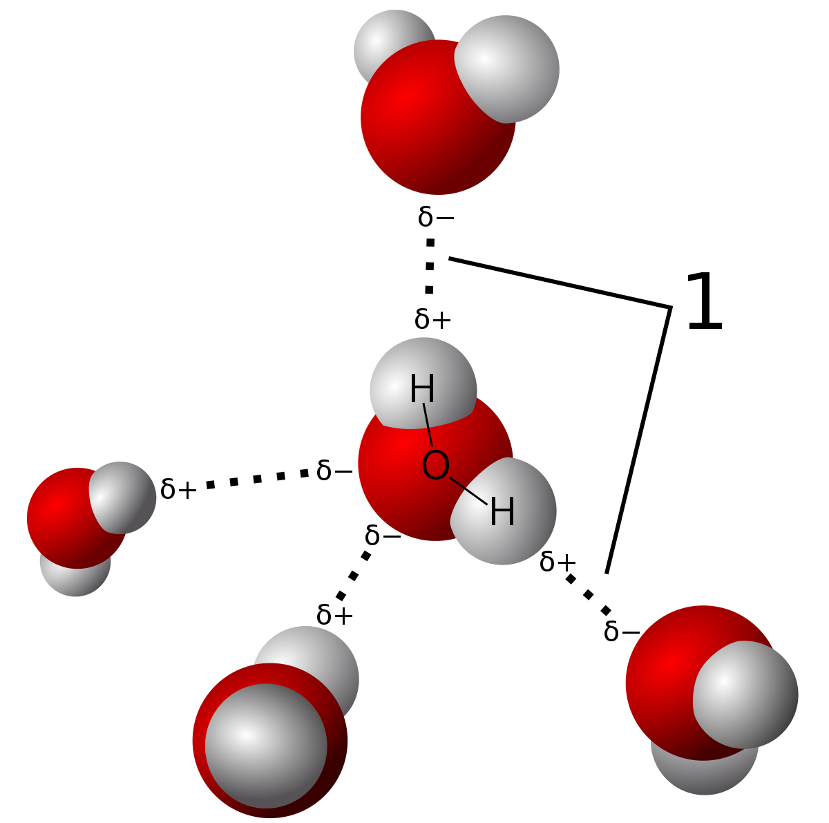
Hydrogen Bonds

Slide 35
Hydrogen Bonds
Corresponds to natural knowledge common to our lives “scientifics”?
Level of “apparent causes and effects”
Notes:
Relates to childhood development of curiosity
A very primitive bonding of good and truth

Slide 36
Salt Bridges (Ionic bonds)
Ion pairing (salt bridging) oppositely charged amino acid side-chains are in close spatial proximity
Notes:
Not a major force in folding but contributes to stability

Slide 37
Ionic Bonds

Slide 38
Strength of an Ionic Bond:
F= q₁q₂ / d² ε*
* ε “dielectric constant” of the solvent
(larger epsilon = smaller attraction!)
Notes:
Epsilon relates to the electric charge which, as a fundamental force of nature,
In the interior of the protein charged amino acids would be surrounded by chemically dissimilar hydrocarbon side chains (CH₃ epsilon = 1) and conditions exist for strong electrostatic
attractions, almost equal in strength to a covalent bond.

Slide 39
Salt Bridges (Ionic bonds)
Salt corresponds, in a good sense, to affection for truth
A salt bridge might therefore correspond to a relationship based on affection for truth.
Now at the level of “cognitions”?
Notes:
1. Possible to speculate also about the Ishmael Rational at this level

Slide 40
Peptide Bonds
Form the backbone of protein structure
Notes:
Intermediate in strength between a single and double bond
In a peptide bond an amino group (NH₂)of one amino acid is linked to a carboxyl (COOH) of an adjacent amino acid with the consequent release of an H₂O molecule.

Slide 41
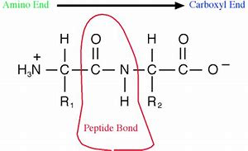
Peptide Bonds

Slide 42
Peptide Bonds
A tight bond that resists rotation
Corresponds to the rational; links the natural mind to the spiritual mind in search of truth?
Notes:
Conformational change, that is shape change is resisted by the peptide bond, once we see the truth from our rational it forms a tight bond in our mind.
Peptide bonds forming the backbone of the protein are interior so the inference of good acting with truth is reasonable.
Think of the birth of the twins, Esau and Jacob, Jacob corresponding to natural truth gripping the heel of Esau, representing the lowest natural good.

Slide 43
Covalent Bonds
Share electron pairs between atoms
Notes:
Greatest between atoms of similar electro-negativities
By far the strongest bonds that hold a molecule together

Slide 44
Covalent Bonds
Correspondence: a marriage: the bond of good and truth?

Slide 45
Hydrophobic Interactions
Hydrophobic amino acid residues are found mainly in the core of the functional (native state) protein!
Notes:
Hydrophobic collapse is a main driver of folding
This occurs by the interaction with water. As H₂O molecules are driven off the hydrocarbon side chains into the surrounding aqueous medium the decreased entropy entailed by the folding hydrophobic amino acids is offset by the increased entropy of the surrounding water.

Slide 46
Hydrophobic Interactions
Hydrophobic lipid (hydrocarbons) corresponds to love (the will)!
Like the hydrophobic amino acids in the folded state, love is interior!
Hydrophobic interactions with water are primary drivers in folding!
Notes:
1. The interaction of good and truth is beautifully and very graphically represented here!

Slide 47
Hydrophobic Amino Acids and Water
Quantum physics of water key to understanding the folding mechanism!
The dielectric constant “ε” of the solvent and the interior environment = an opportunity for “fine tuning”!

Slide 48
New Horizons!
Long range interactions
Solitons
The cell as an “electrome”

Slide 49
“Everything in the universe that is in harmony with God’s plan relates to goodness and truth.”
New Jerusalem and its Heavenly Doctrine 11

Slide 50
Arcana Coelestia 3629
“Also, they do not know what correspondence is and what influx is, and that when the spiritual flows into the organic forms belonging to the body, it establishes the living workings such as occur there. Nor do they know that without such influx and correspondence not even the smallest parts of the body can have life or be set in motion.”

Slide 51
Chaperone Proteins
AKA “heat shock” or “stress” proteins
Notes:
These Intra cellular protein molecules are classified into discrete families by weight in kilodaltons. They increase dramatically in response to stress
Act as midwives for nascent polypeptide chains and nursemaids to assist in folding
Prevent aggregation of proteins in the crowded intracellular environment
Act like hospice nurses in transporting misfolded or redundant proteins to the lysosome for recycling

Slide 52
Chaperone Proteins
Correspondence to celestial angels, spiritual angels and good spirits?

Slide 53
“Behold I Make All Things New”
An additional role of chaperone protein molecules!
Notes:
According to the late Susan Lee Lindquist of MIT chaperone molecules may preserve novel protein, totally new to the cell, in anticipation of a possible future use.

Slide 54
Chaperone Proteins
May preserve a totally new protein for some future use!
How does it recognize it as potentially useful?

Slide 55
Arcana Coelestia 5131
“… To enable the cause to exist the end must act on the level where the cause belongs, calling on assistant means to help it –the end- to bring the cause into existence, and to enable the effect to exist the cause likewise must act on the level where the effect belongs, by calling on assistant...”
Notes:
1. Consider the correspondence of chaperone proteins to celestial angels, spiritual angels and good spirits who assist us through mediate influx in our goal towards regeneration.

Slide 56
Arcana Coelestia 4523
“…Thus the whole body is an organ composed of the deepest arcana belonging to everything which exists within the natural world, and its formation is determined by hidden forces by which all things act and the wonderful manner in which they flow.”

Slide 57
Fine Tuning
End ➔ Cause ➔ Effect
⬆
Transient, small fluctuations in constants of nature
Notes:
1. We are looking for a theory that uses brief, local changes as causes, when ends anticipate effects.

Slide 58
Fine Tuning
“The existence of life as we know it depends delicately on many seemingly fortuitous features of the laws of physics and the structure of the universe.”
Paul Davies,
The Mind Of God

Slide 59
Fine Tuning
“There are three types of change to consider. Tiny infinitesimal changes are possible. If we change the value of the fine structure constant only in the 20th decimal place there will be no bad consequences for life…if we change it by a very small amount, say the 2nd decimal place, then the changes become more significant.
Continued on next slide

Slide 60
Fine Tuning
Continued from last slide
Properties of atoms are altered and complicated processes like protein folding or DNA replication may be adversely affected.”
John Barrow
The Constants of Nature

Slide 61
Fine Structure Constant

Slide 62
Arcana Coelestia 4524
“And because there must be a continuous connection with the spiritual world in order that every single thing may be kept in being, or constantly come into being, it follows that the purer or more interior things within the natural order, and consequently within the human being, spring from that world, and the purer or more interior things are forms such as are able to receive influx…”

